Slide 1
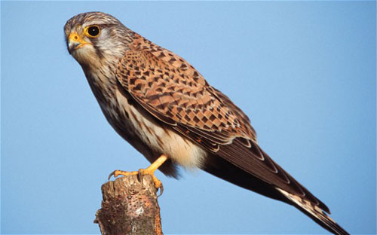
Welcome to St Helen’s Primary School
You will be in Kestrel class

Slide 2
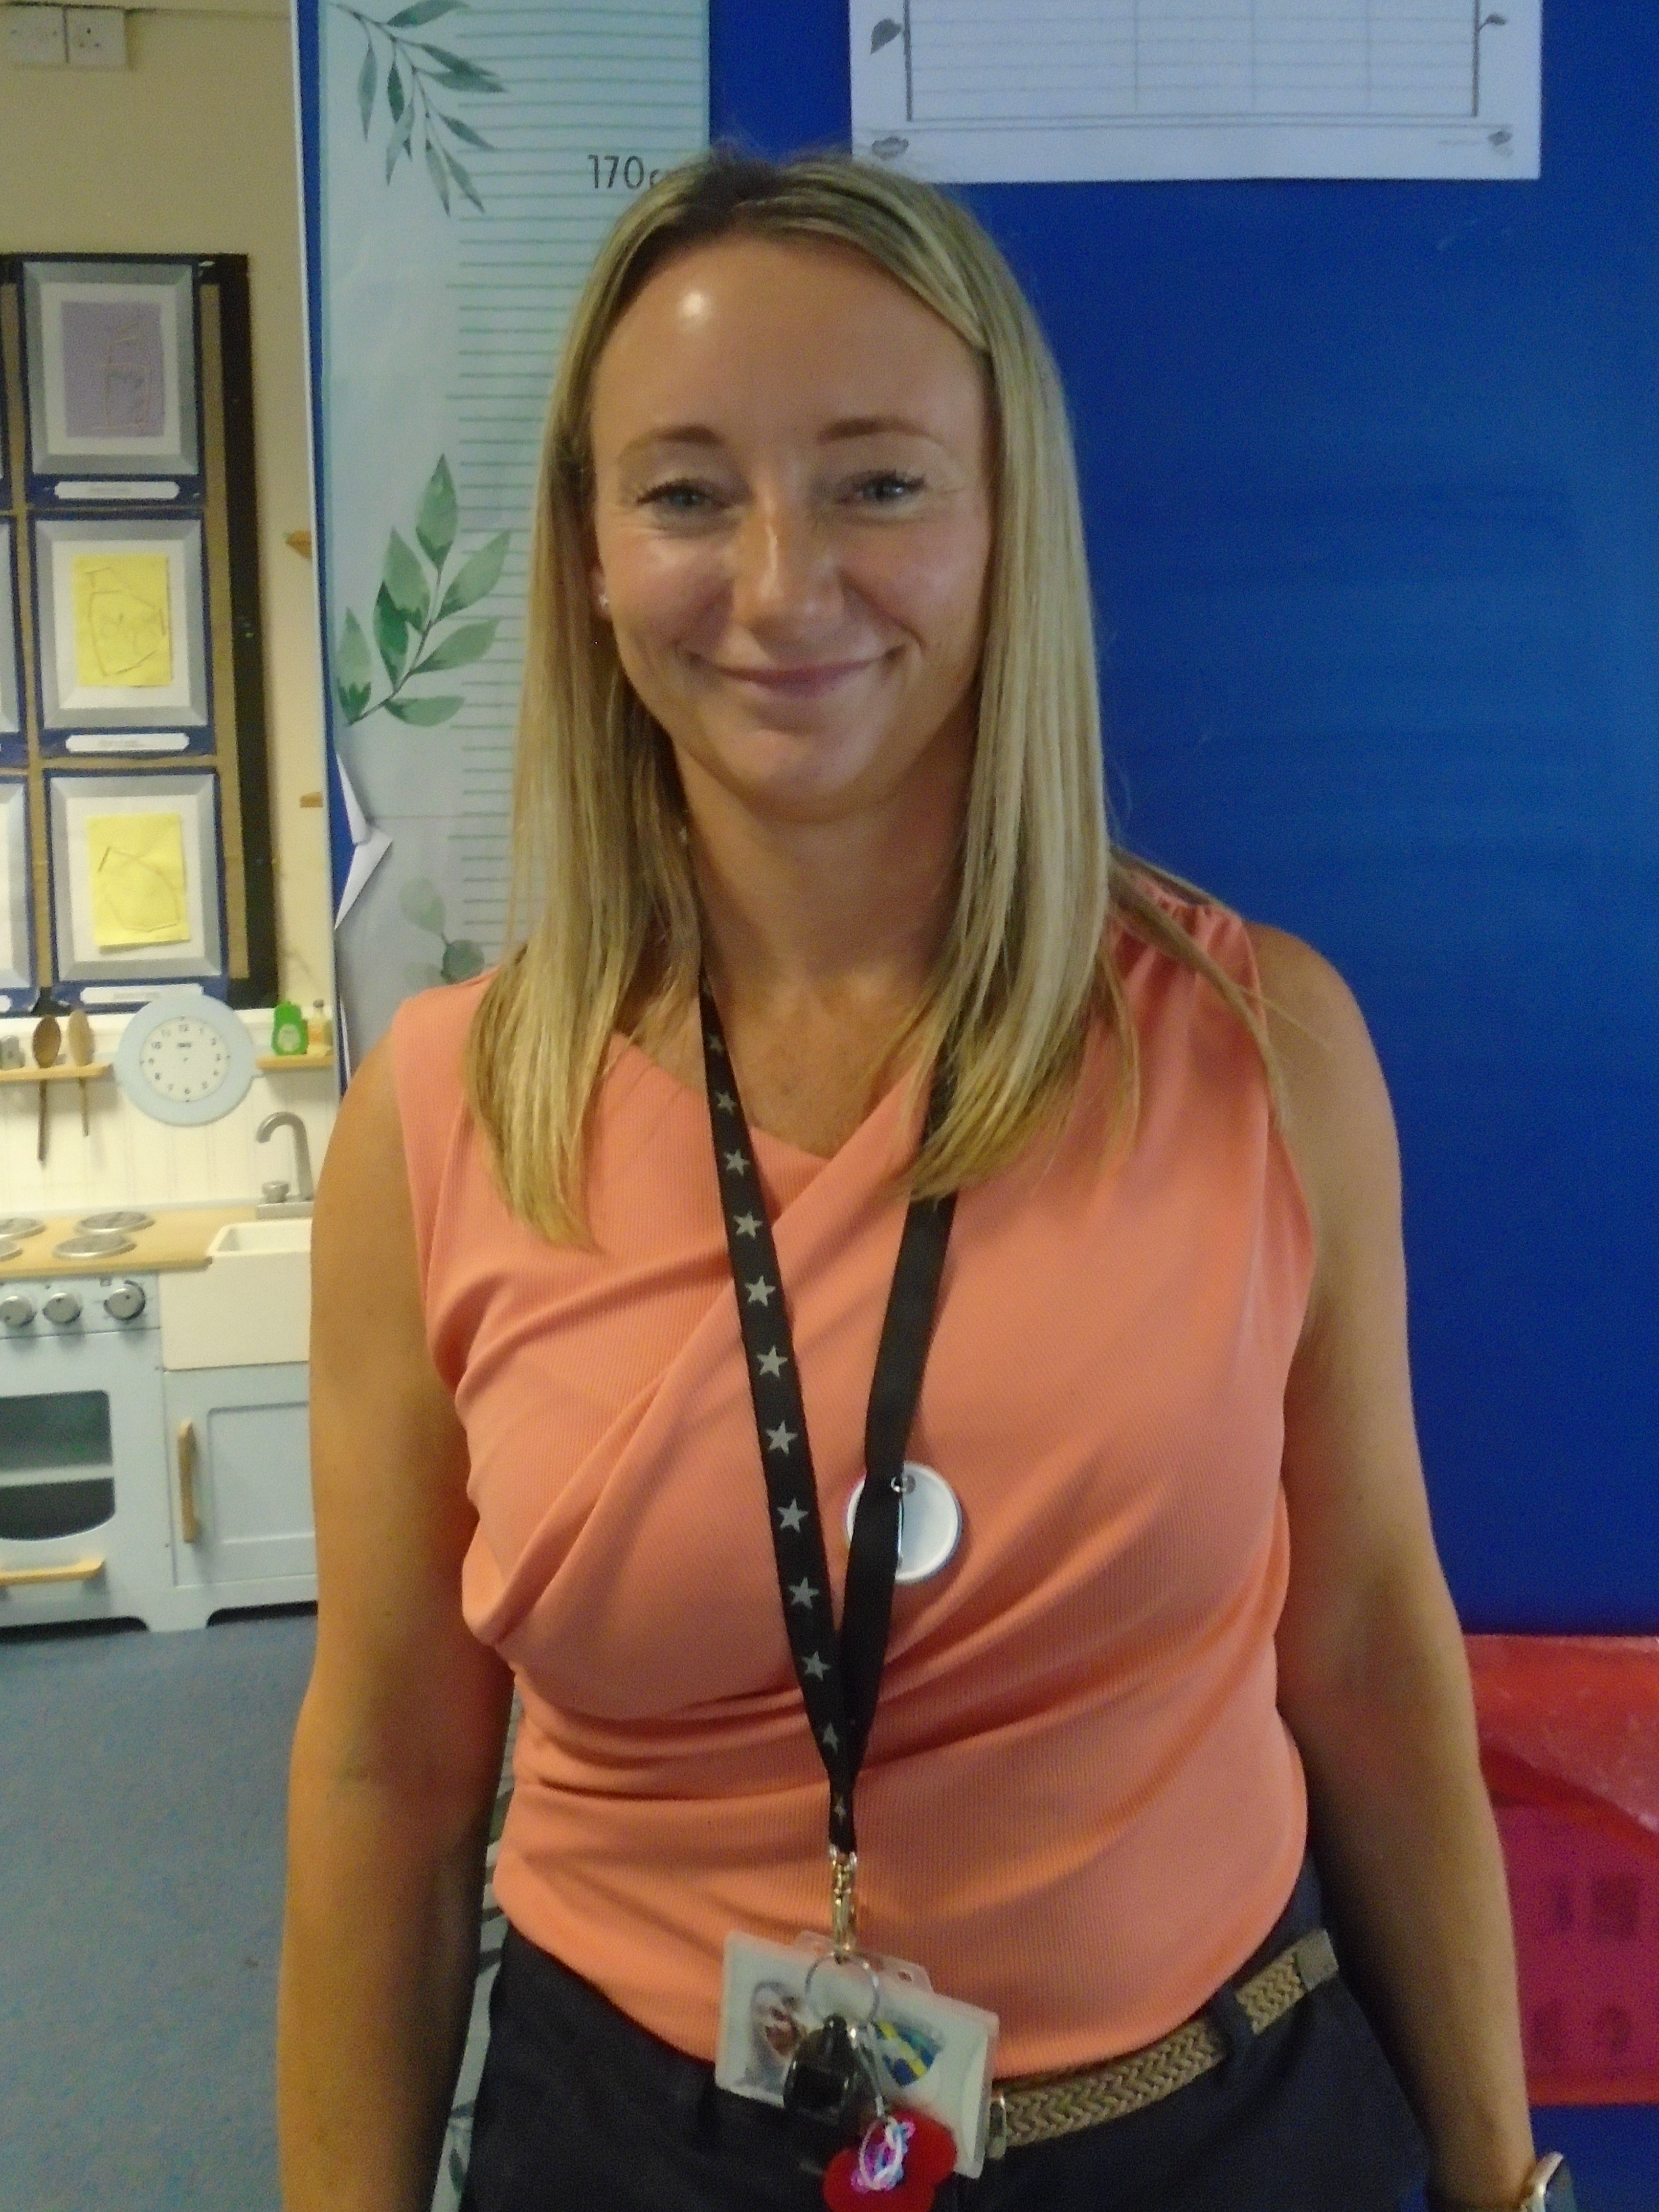
Hello everyone, my name is Mrs Westgate and I will be your Teacher in September on Monday, Tuesday & Wednesday.
Here are a few things all about me!
My favourite colour - Navy blue
My favourite food – Curry
My favourite animal - Cat
My favourite picture book – The Hospital Dog
My favourite place – The beach
Something I think I am good at - Tennis
Something I would like to get better at - Spanish
Notes:
NOTE: To change images on this slide, select a picture and delete it. Then click the Insert Picture icon in the placeholder to insert your own image.

Slide 3
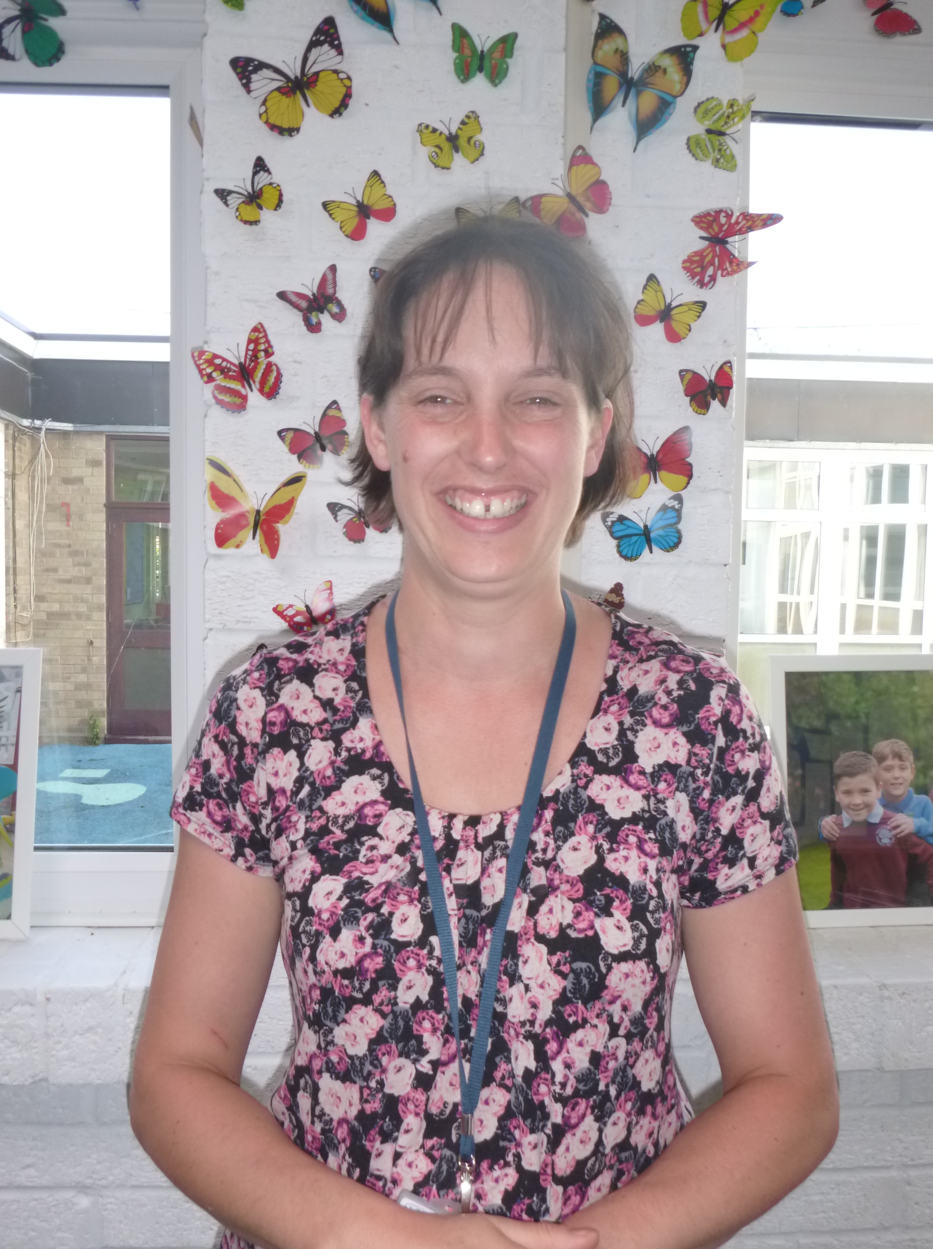
My name is Mrs Fear. I will be your Teacher every Thursday and Friday.
Here are a few things all about me!
My favourite colour - Red
My favourite food - Lasagne and garlic bread
My favourite animal - Cat
My favourite picture book - The Very Hungry Caterpillar
My favourite place - By the seaside with my family
Something I think I am good at - Gardening
Something I would like to get better at - Playing the piano
Notes:
NOTE: To change images on this slide, select a picture and delete it. Then click the Insert Picture icon in the placeholder to insert your own image.

Slide 4
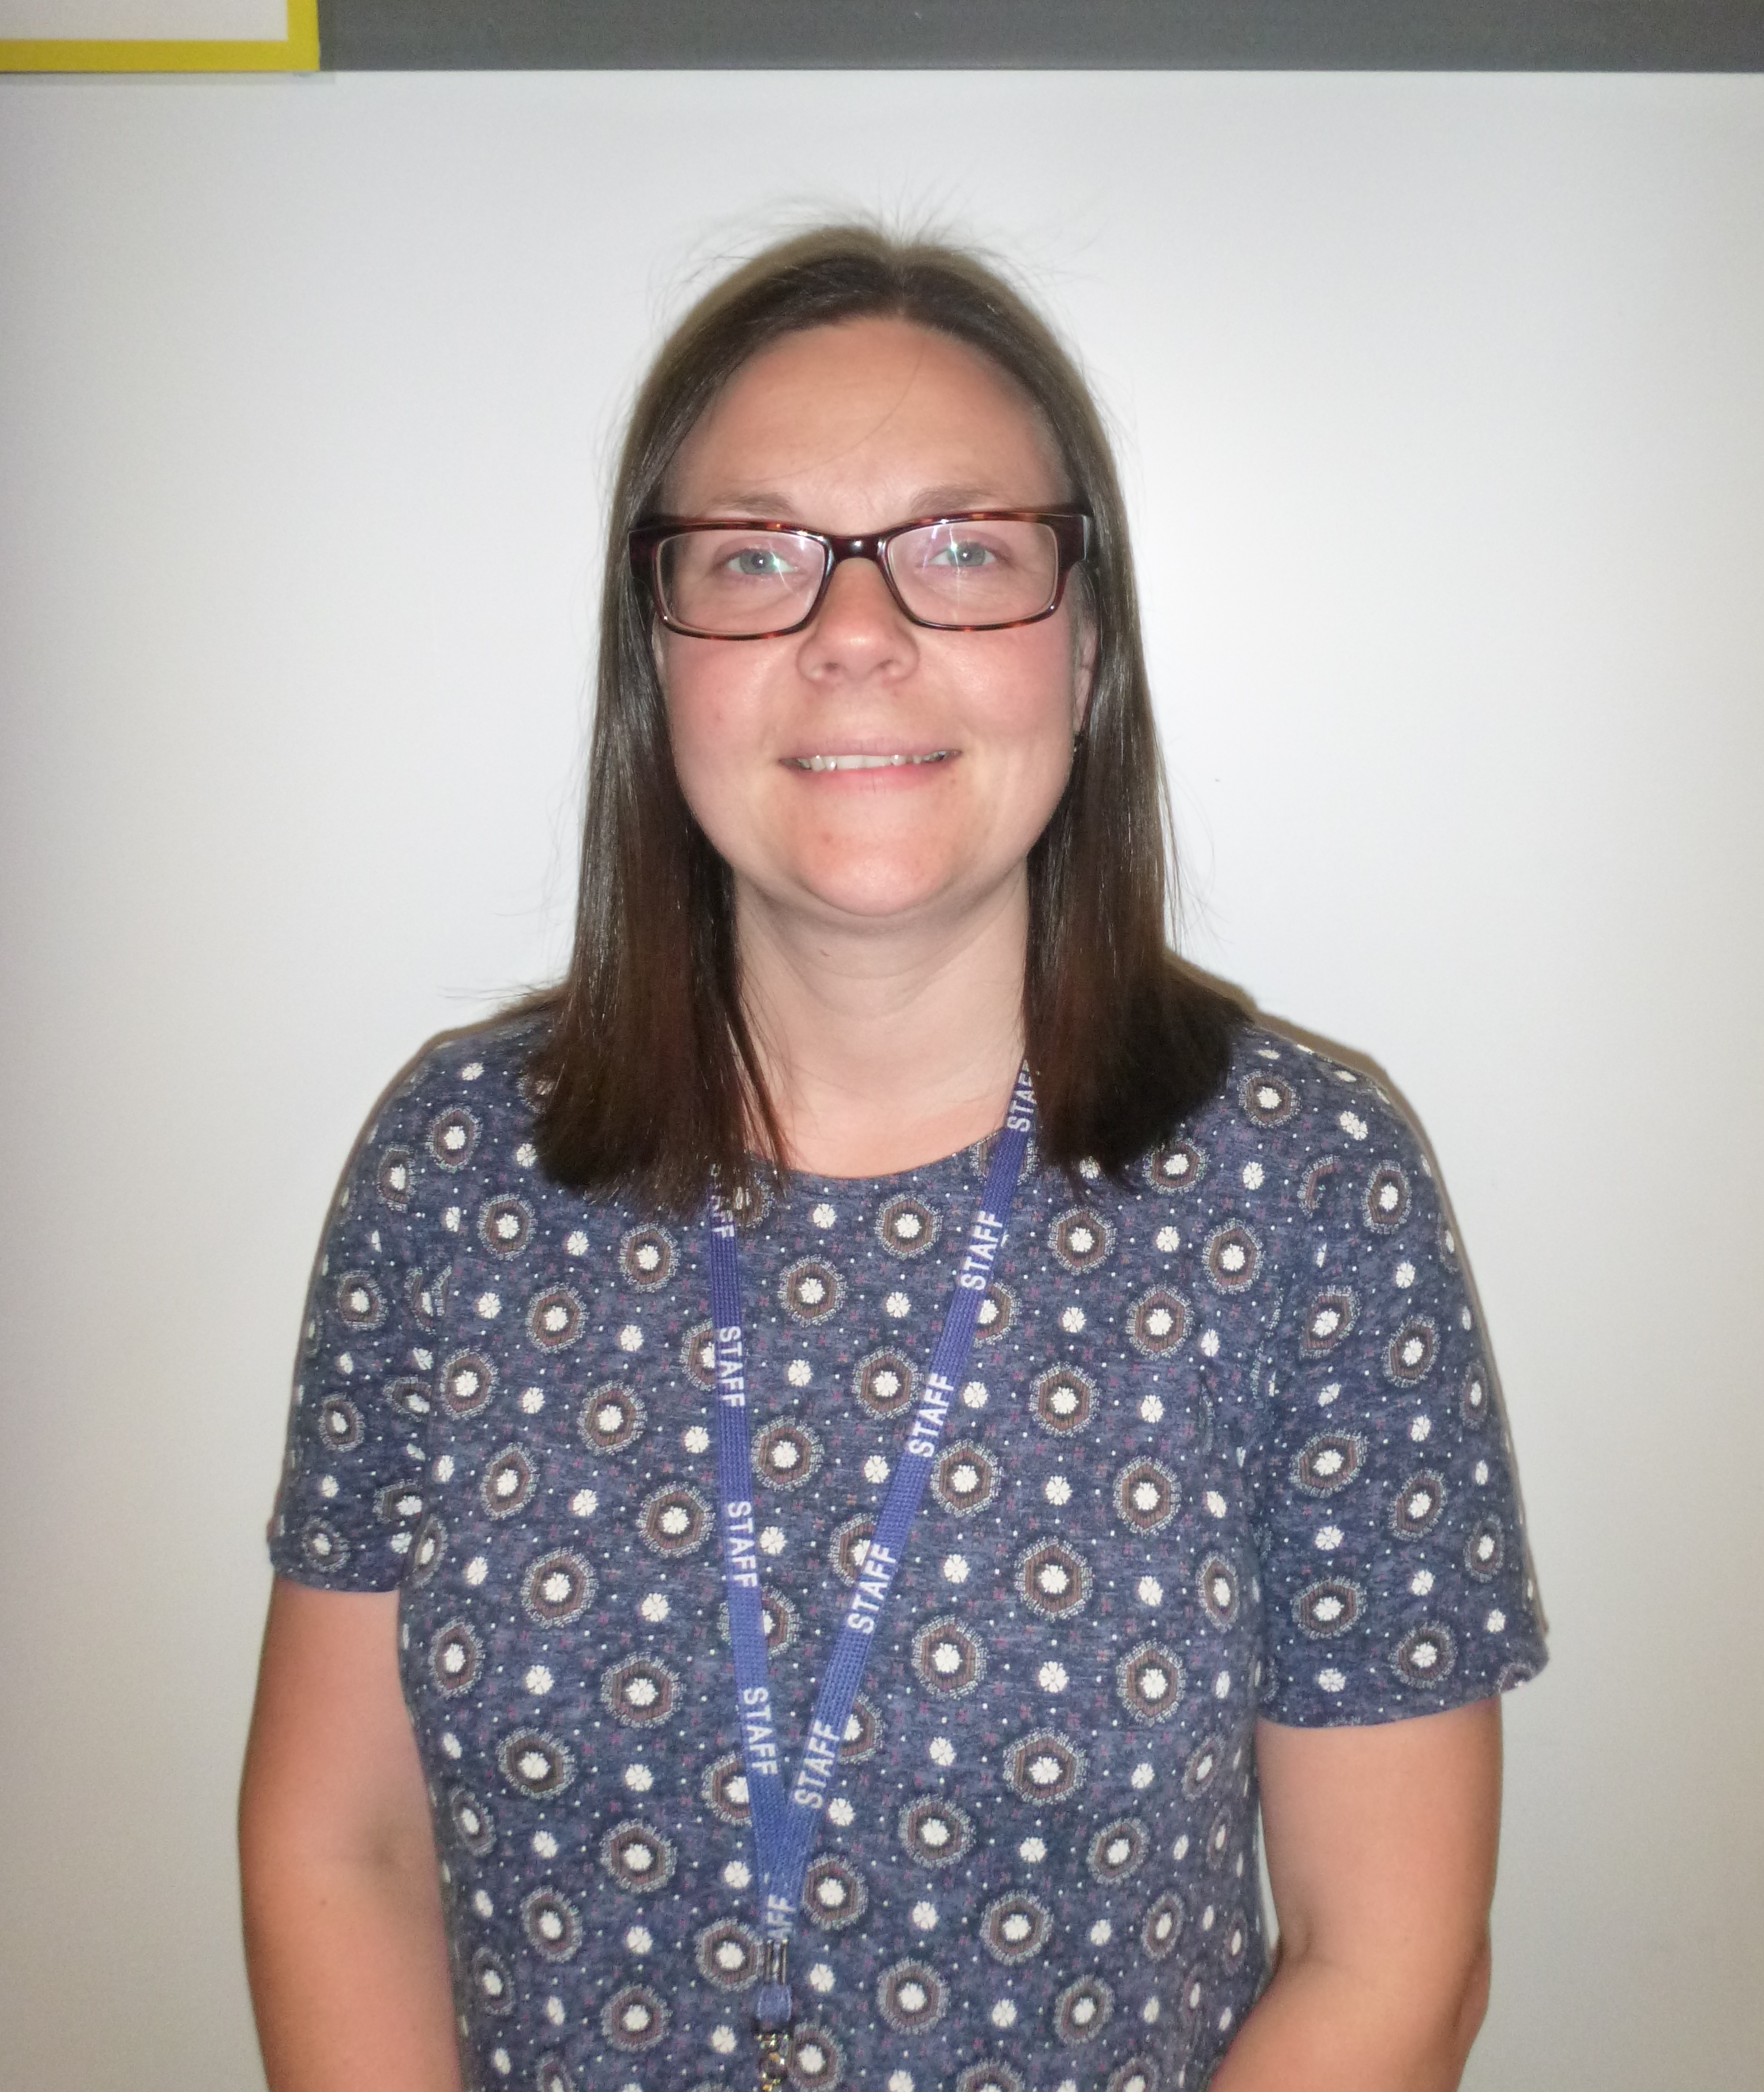
My name is Mrs Miller and I am the Early Years Leader. You will see me in class on a Thursday.
Here are a few things all about me!
My favourite colour - Blue
My favourite food – Pizza
My favourite animal - Dog
My favourite picture book – Stick Man
My favourite place – In the Woods
Something I think I am good at - Making things
Something I would like to get better at - Swimming
Notes:
NOTE: To change images on this slide, select a picture and delete it. Then click the Insert Picture icon in the placeholder to insert your own image.

Slide 5
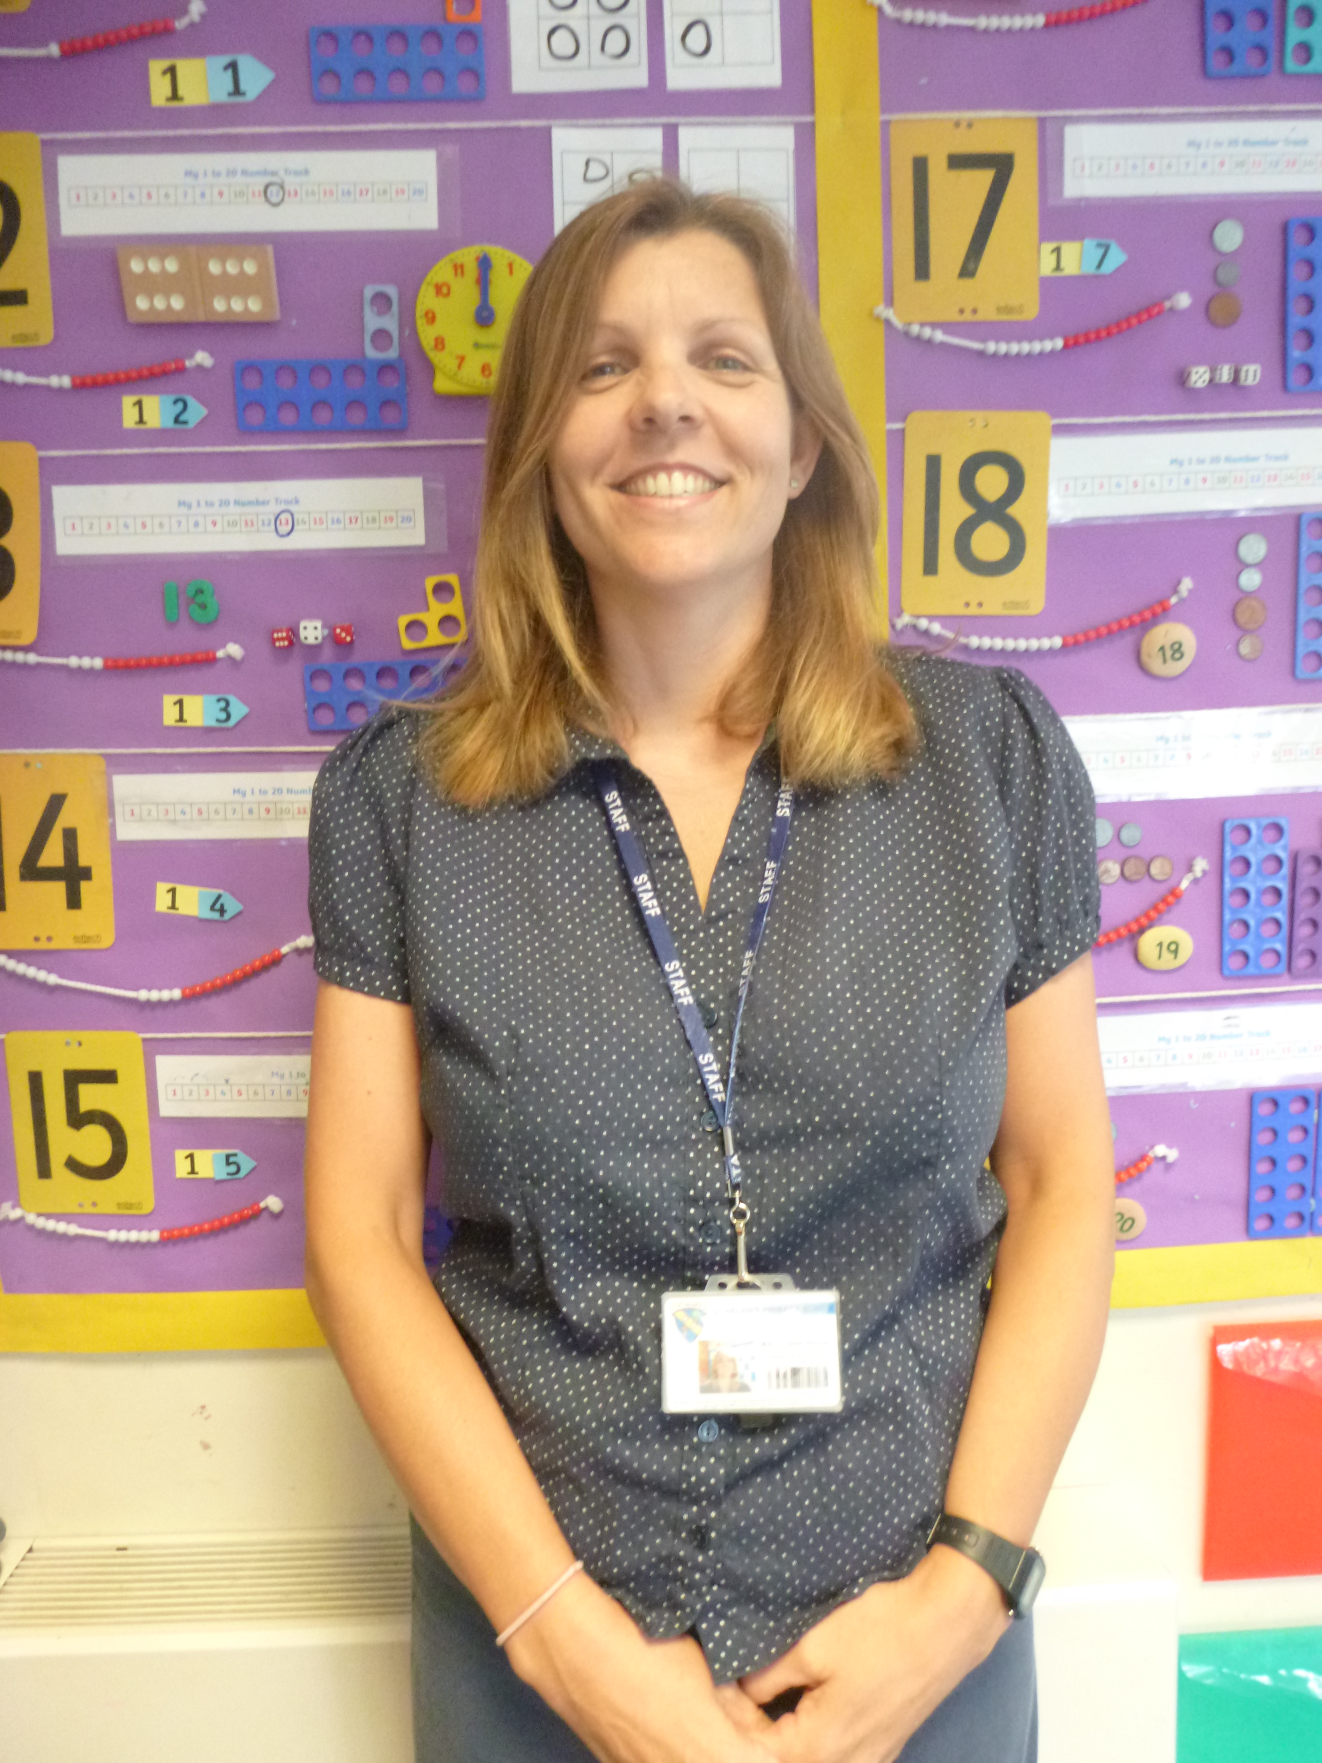
I am Mrs Welton. I am a Teaching Assistant from Monday to Thursday.
Here are a few things all about me!
My favourite colour - Purple
My favourite food - Italian (but chocolate comes a close second)
My favourite animal - Dog
My favourite picture book - One Snowy Night (Percy the park-keeper)
My favourite place - At home when all my family are together, especially with my grandson
Something I think I am good at - Swimming
Something I would like to get better at – Make more time to read for pleasure
Notes:
NOTE: To change images on this slide, select a picture and delete it. Then click the Insert Picture icon in the placeholder to insert your own image.

Slide 6
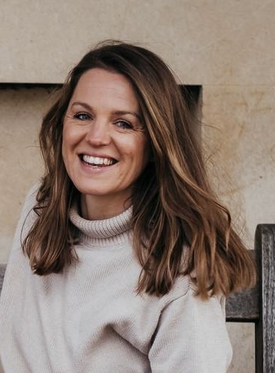
I am Mrs Round. I am a Teaching Assistant every Friday.
Here are a few things all about me!
My favourite colour - I don’t have a favourite colour. I love all of the colours.
My favourite food – Roast dinner
My favourite animal - A duck. Their “quack” makes me smile.
My favourite picture book – The Koala Who Could
My favourite place – By the sea or in the garden.
Something I think I am good at - Listening and understanding others.
Something I would like to get better at - Yoga
Notes:
NOTE: To change images on this slide, select a picture and delete it. Then click the Insert Picture icon in the placeholder to insert your own image.

Slide 7
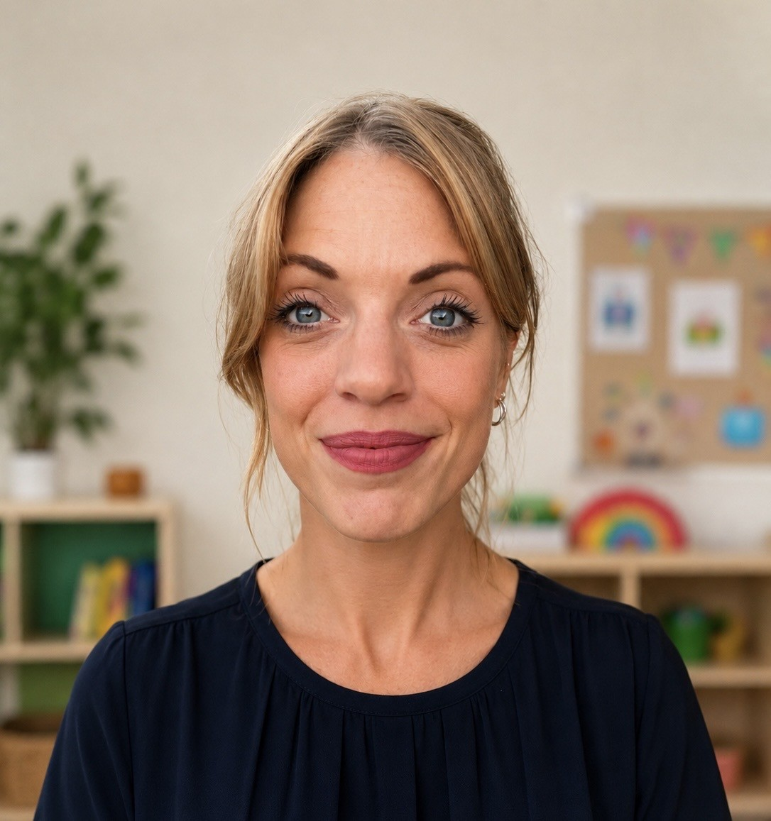
I am Mrs Richardson. I am a Teaching Assistant in Kestrel class.
Here are a few things all about me!
My favourite colour - Green
My favourite food - Mexican
My favourite animal - Horses
My favourite picture book - The hairy toe - Daniel Postgate
My favourite place - Cornwall
Something I’m good at - Balancing objects on my head for extended periods of time
Something I would like to get better at - Meditation
Notes:
NOTE: To change images on this slide, select a picture and delete it. Then click the Insert Picture icon in the placeholder to insert your own image.

Slide 8
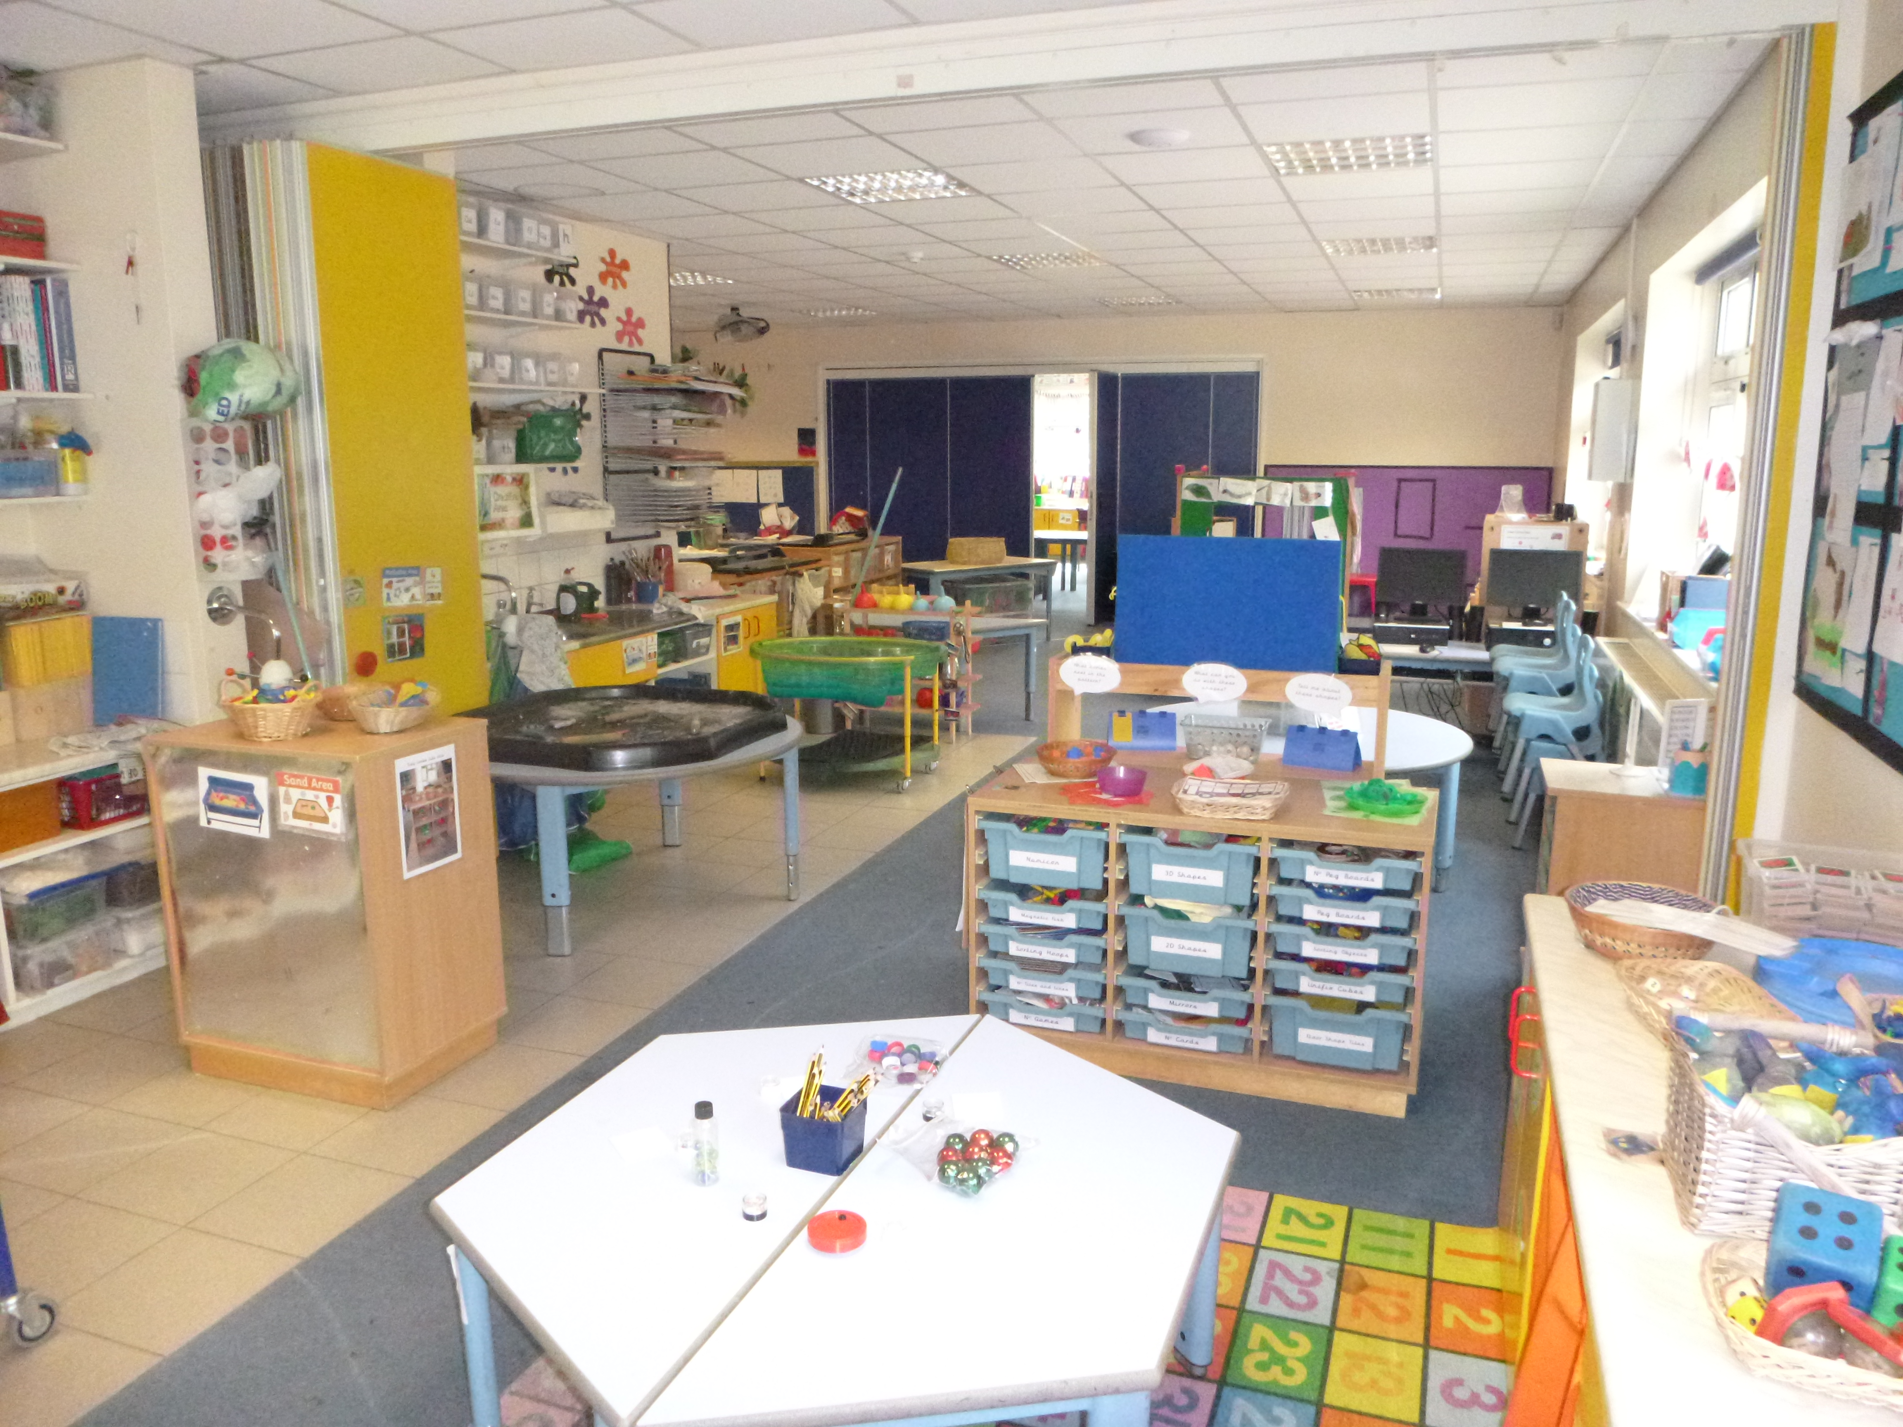
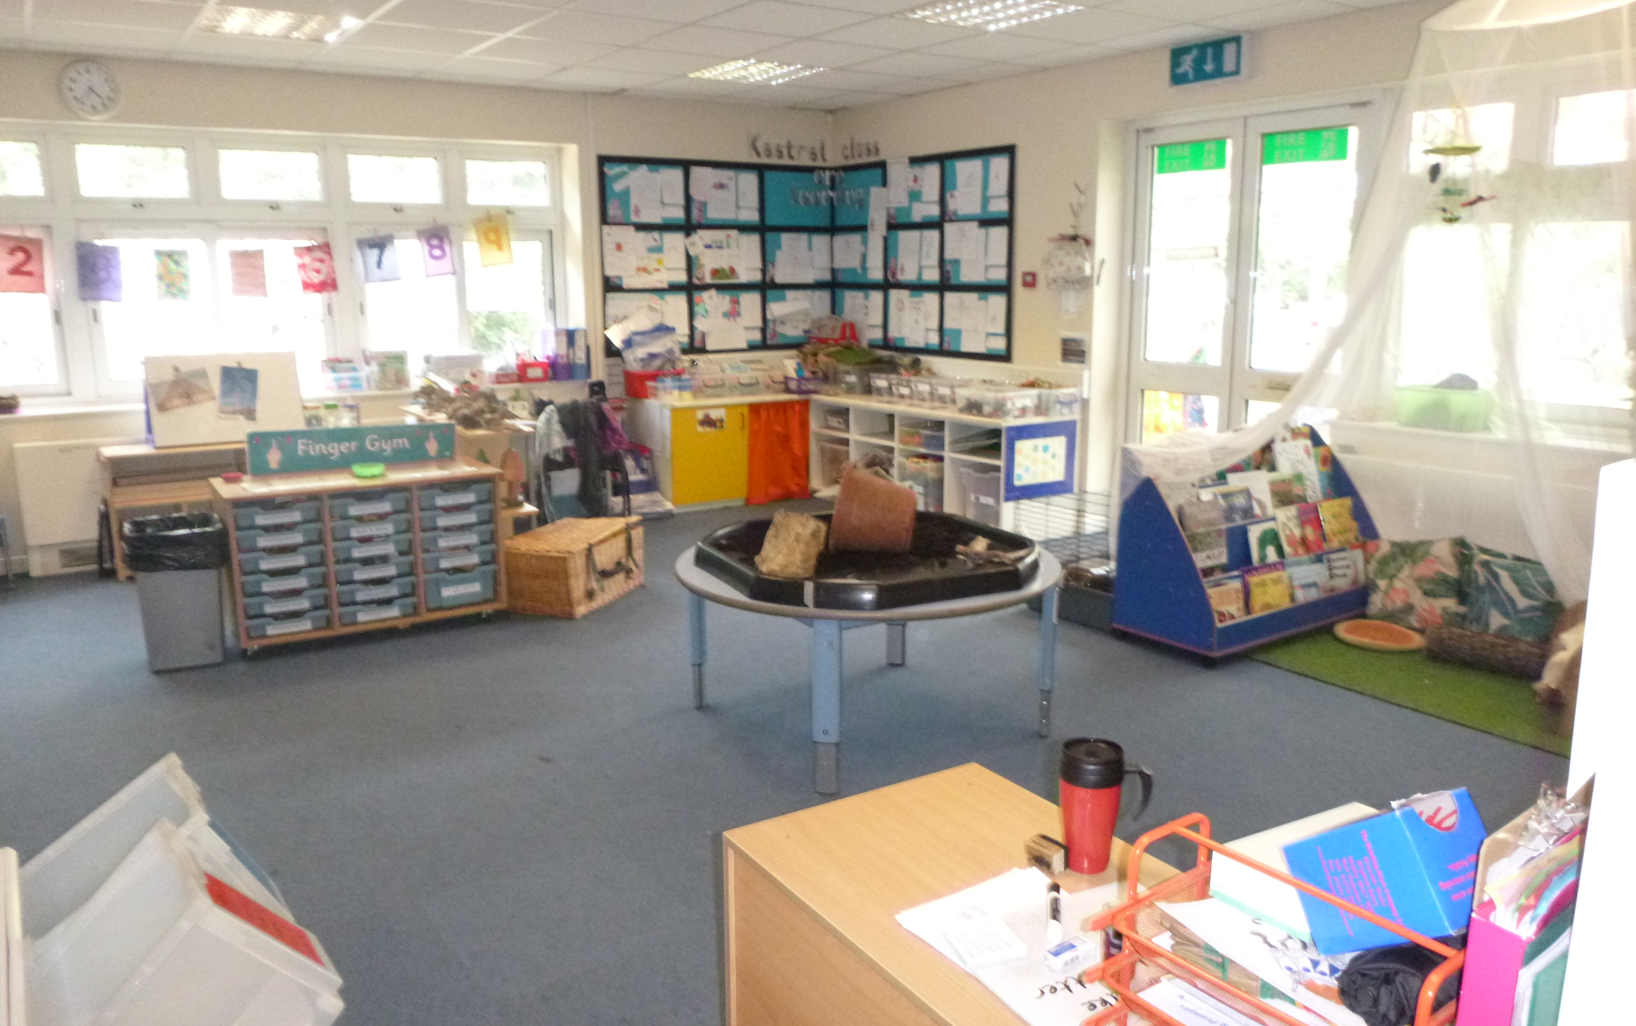
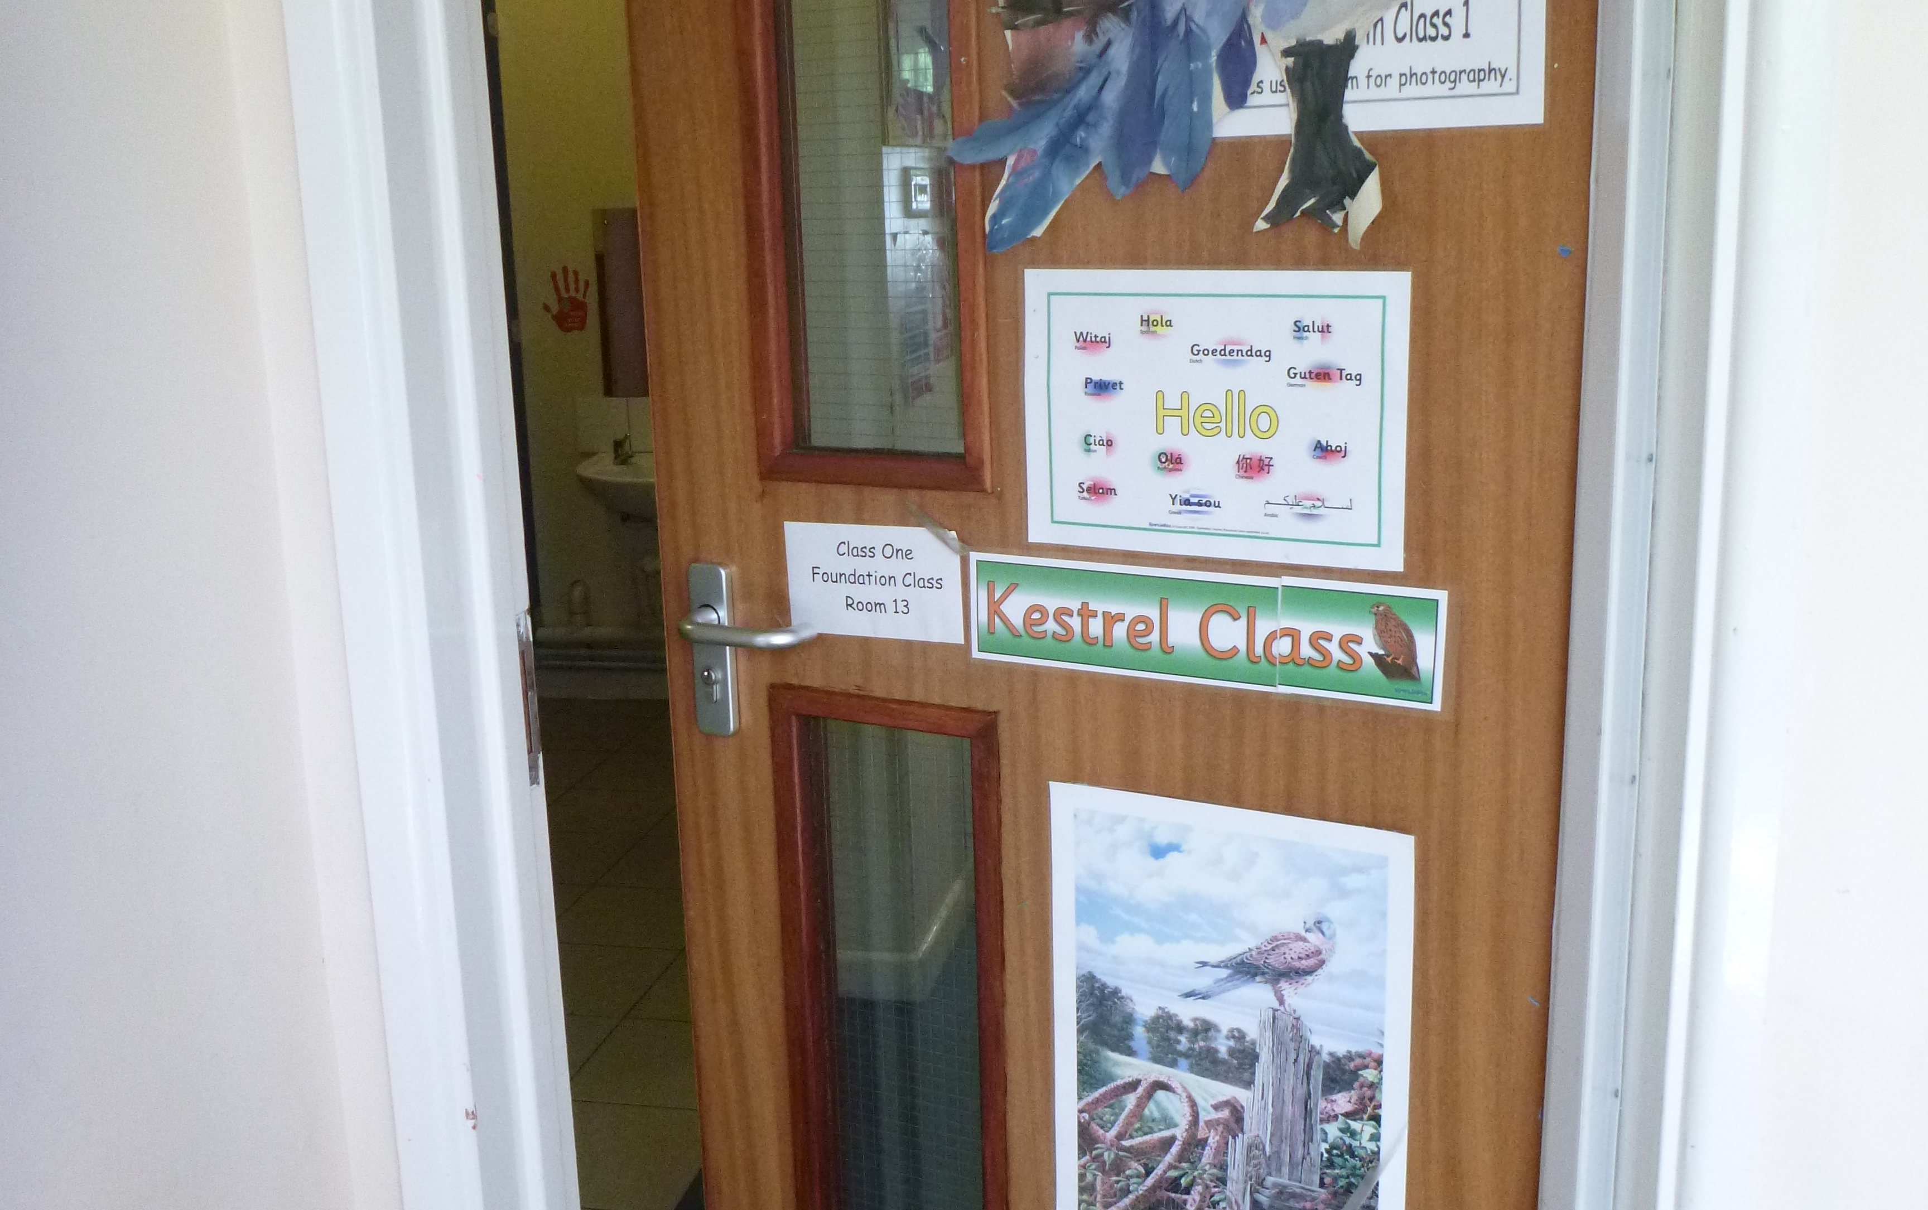
This is our classroom. We have lots of room to play and explore.
Notes:
NOTE: To change images on this slide, select a picture and delete it. Then click the Insert Picture icon in the placeholder to insert your own image.

Slide 9
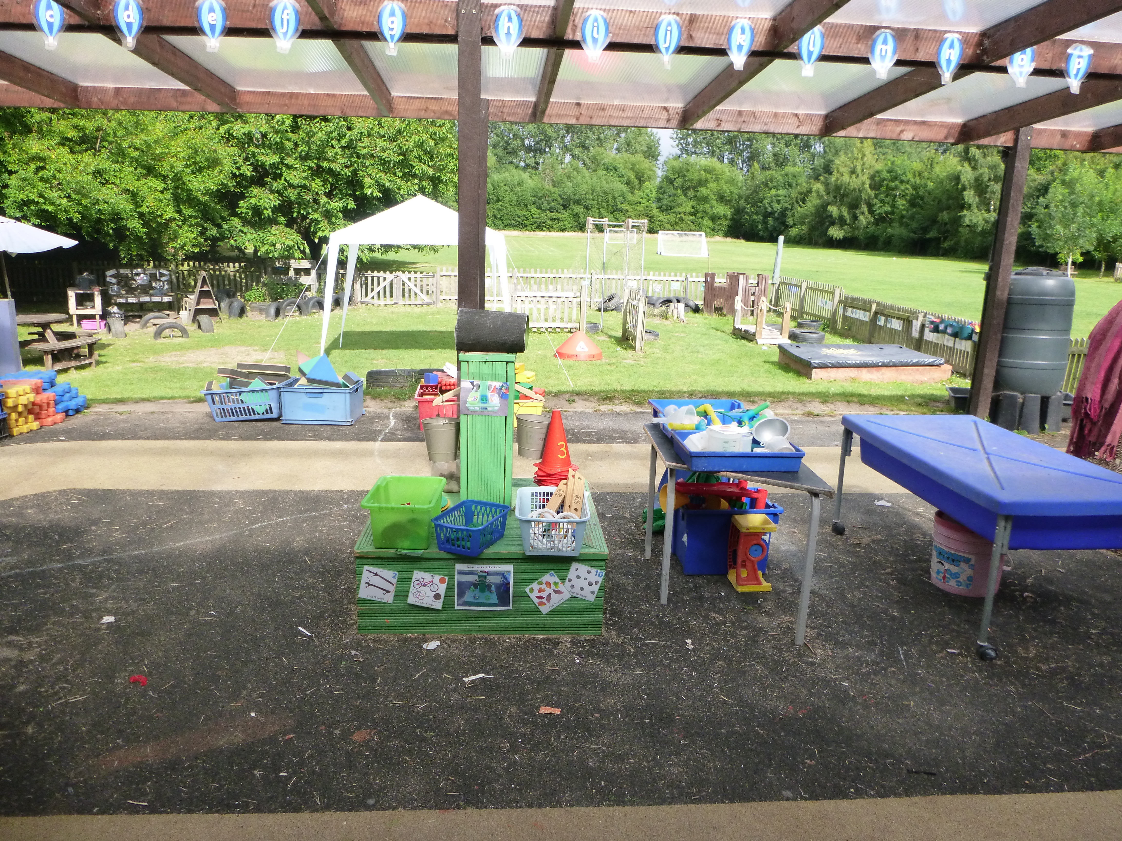
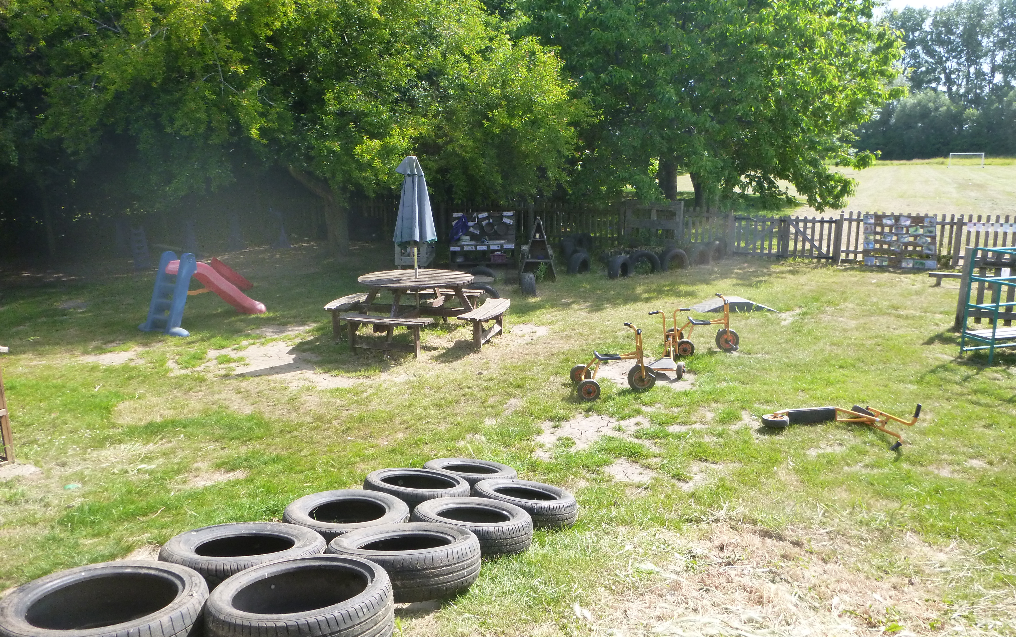
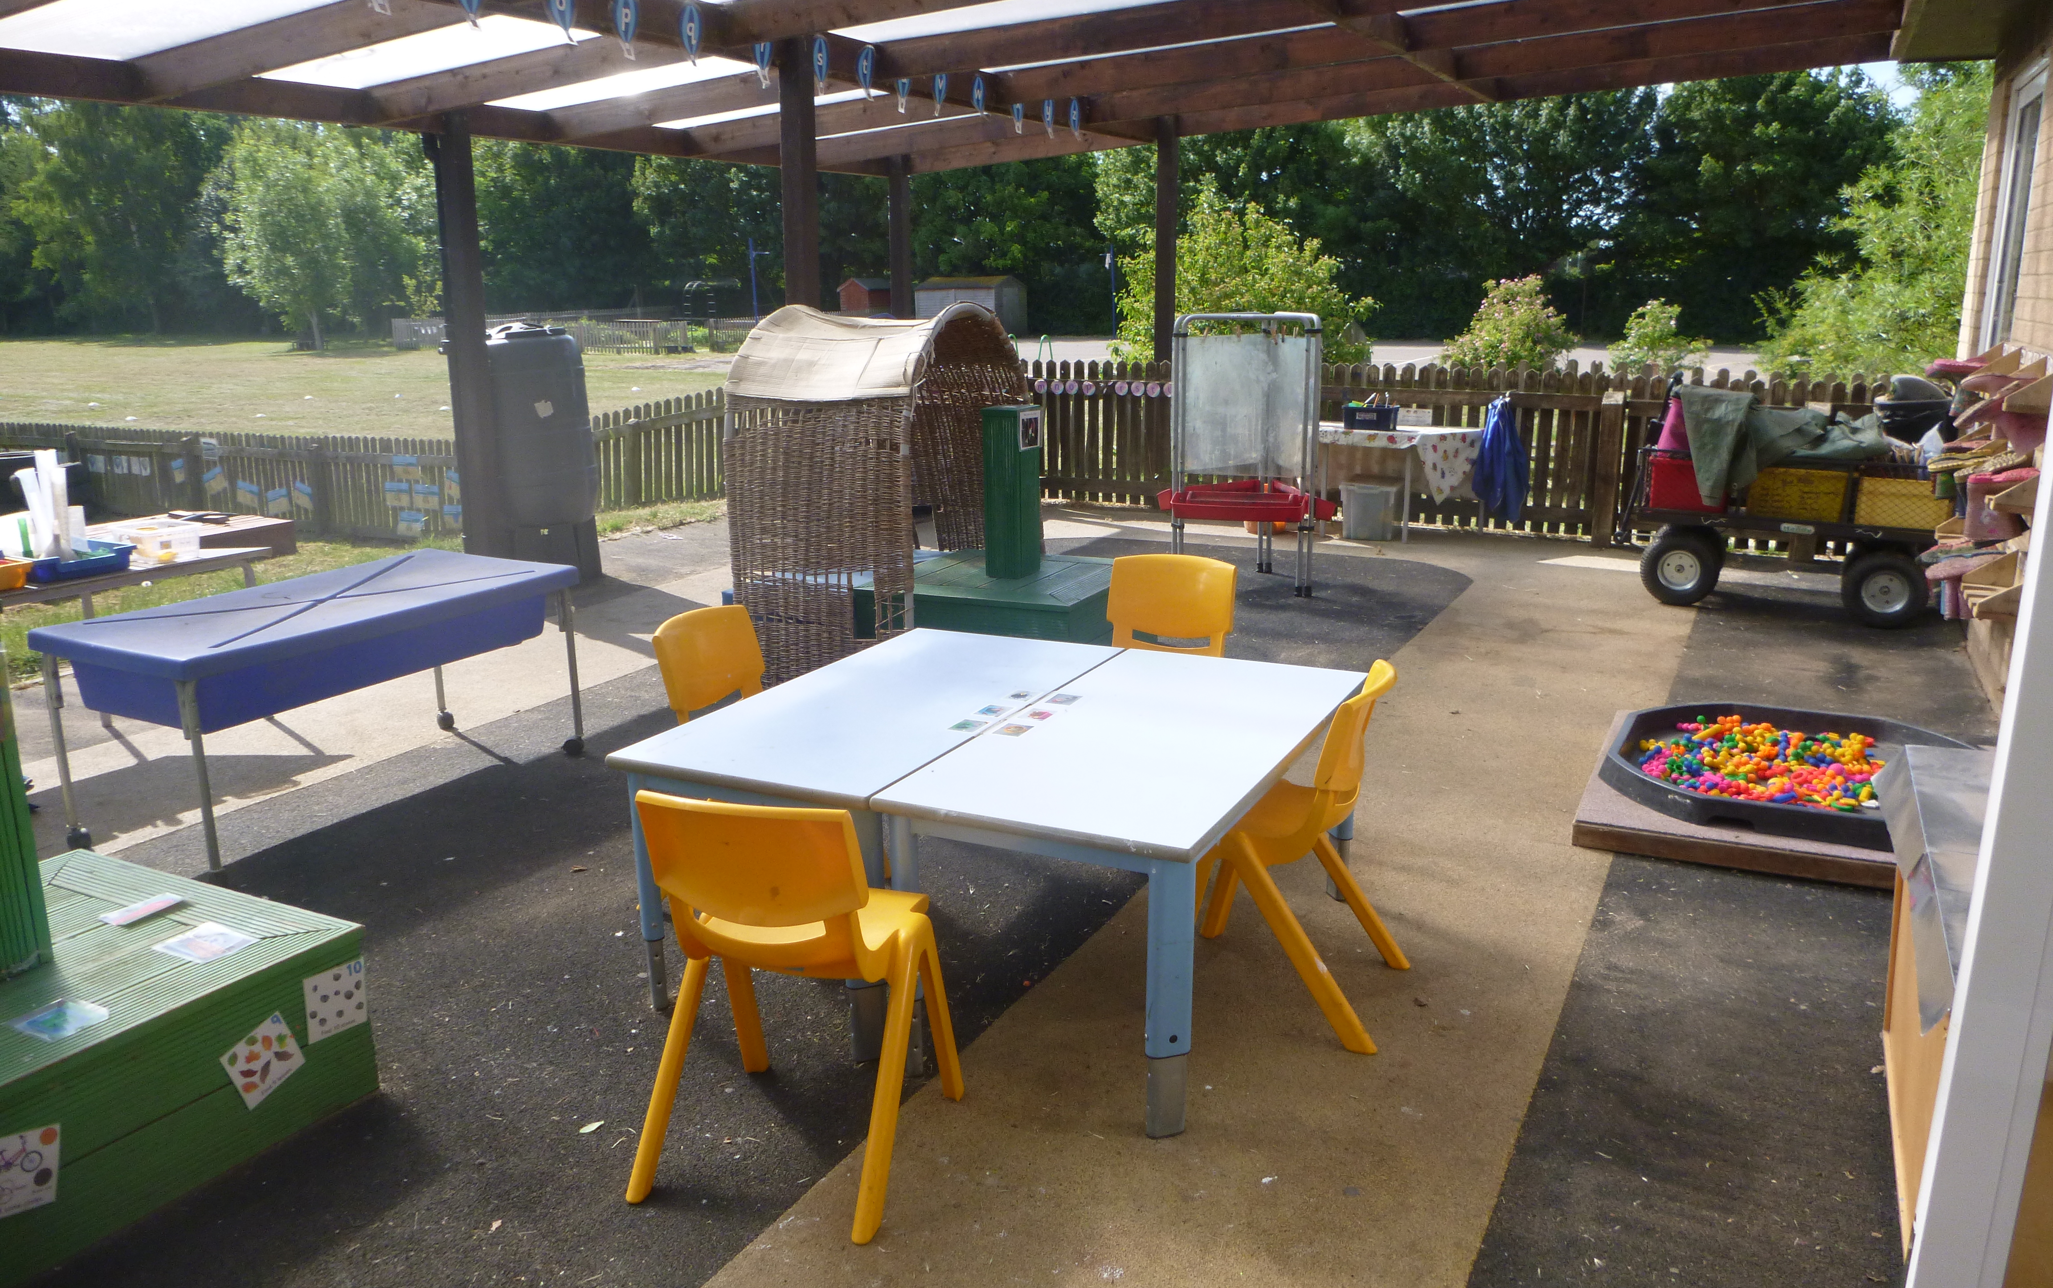
We have lots of space to play outside too.
Notes:
NOTE: To change images on this slide, select a picture and delete it. Then click the Insert Picture icon in the placeholder to insert your own image.

Slide 10
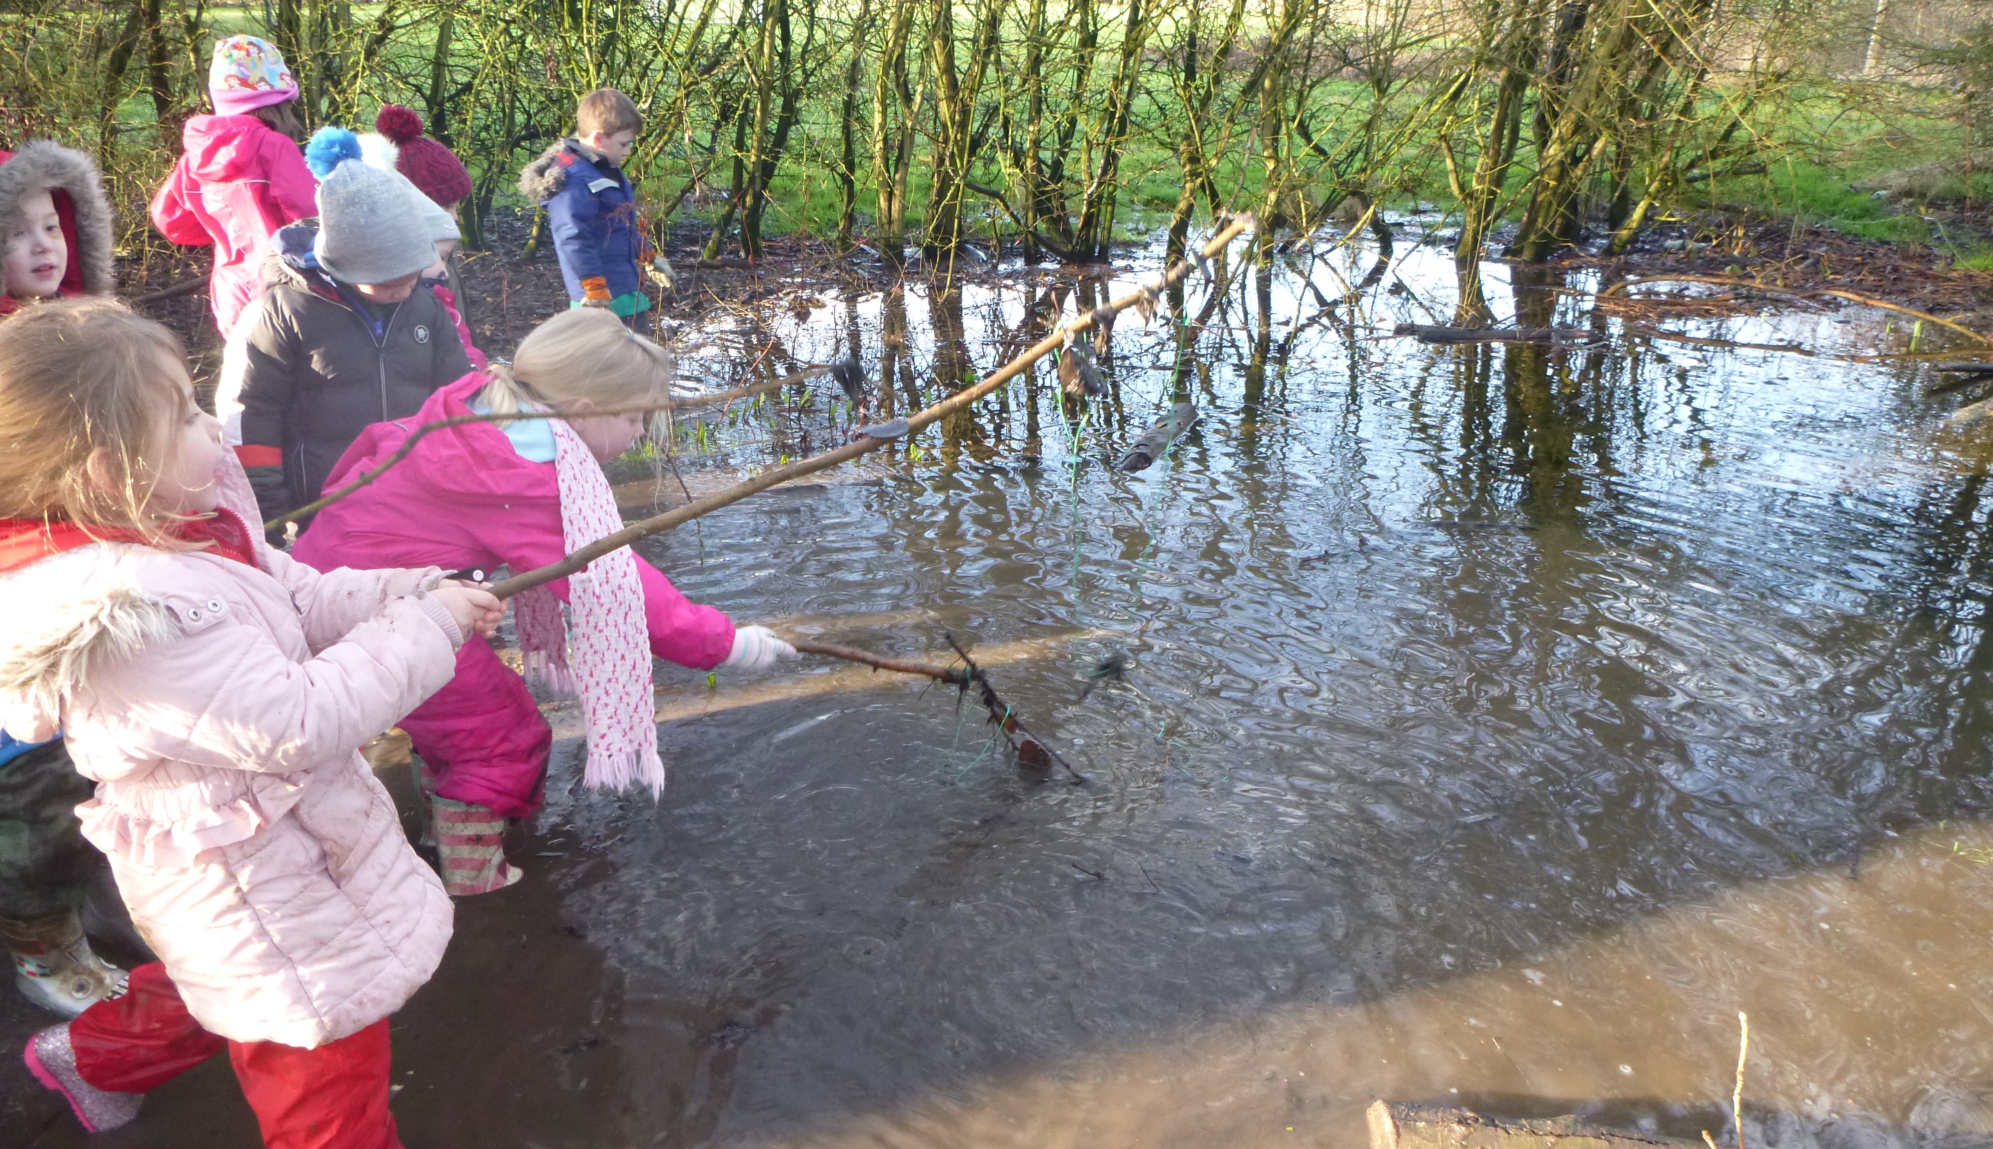
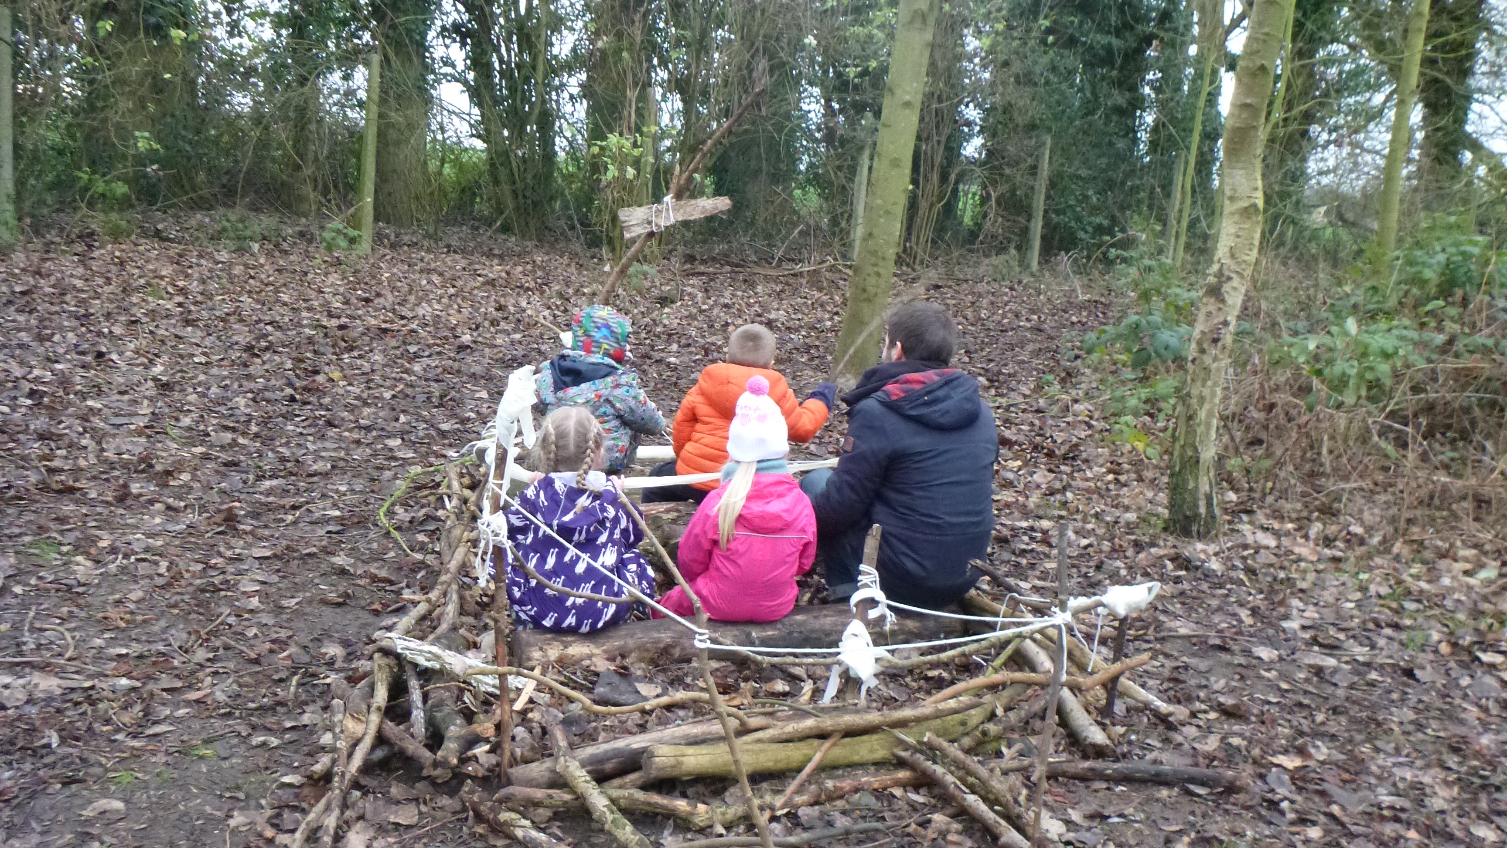
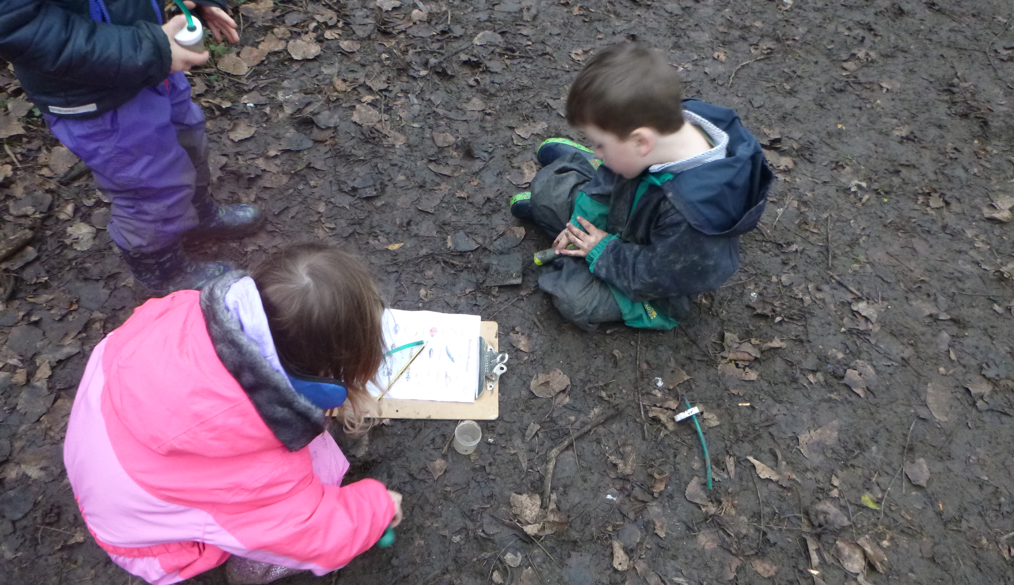
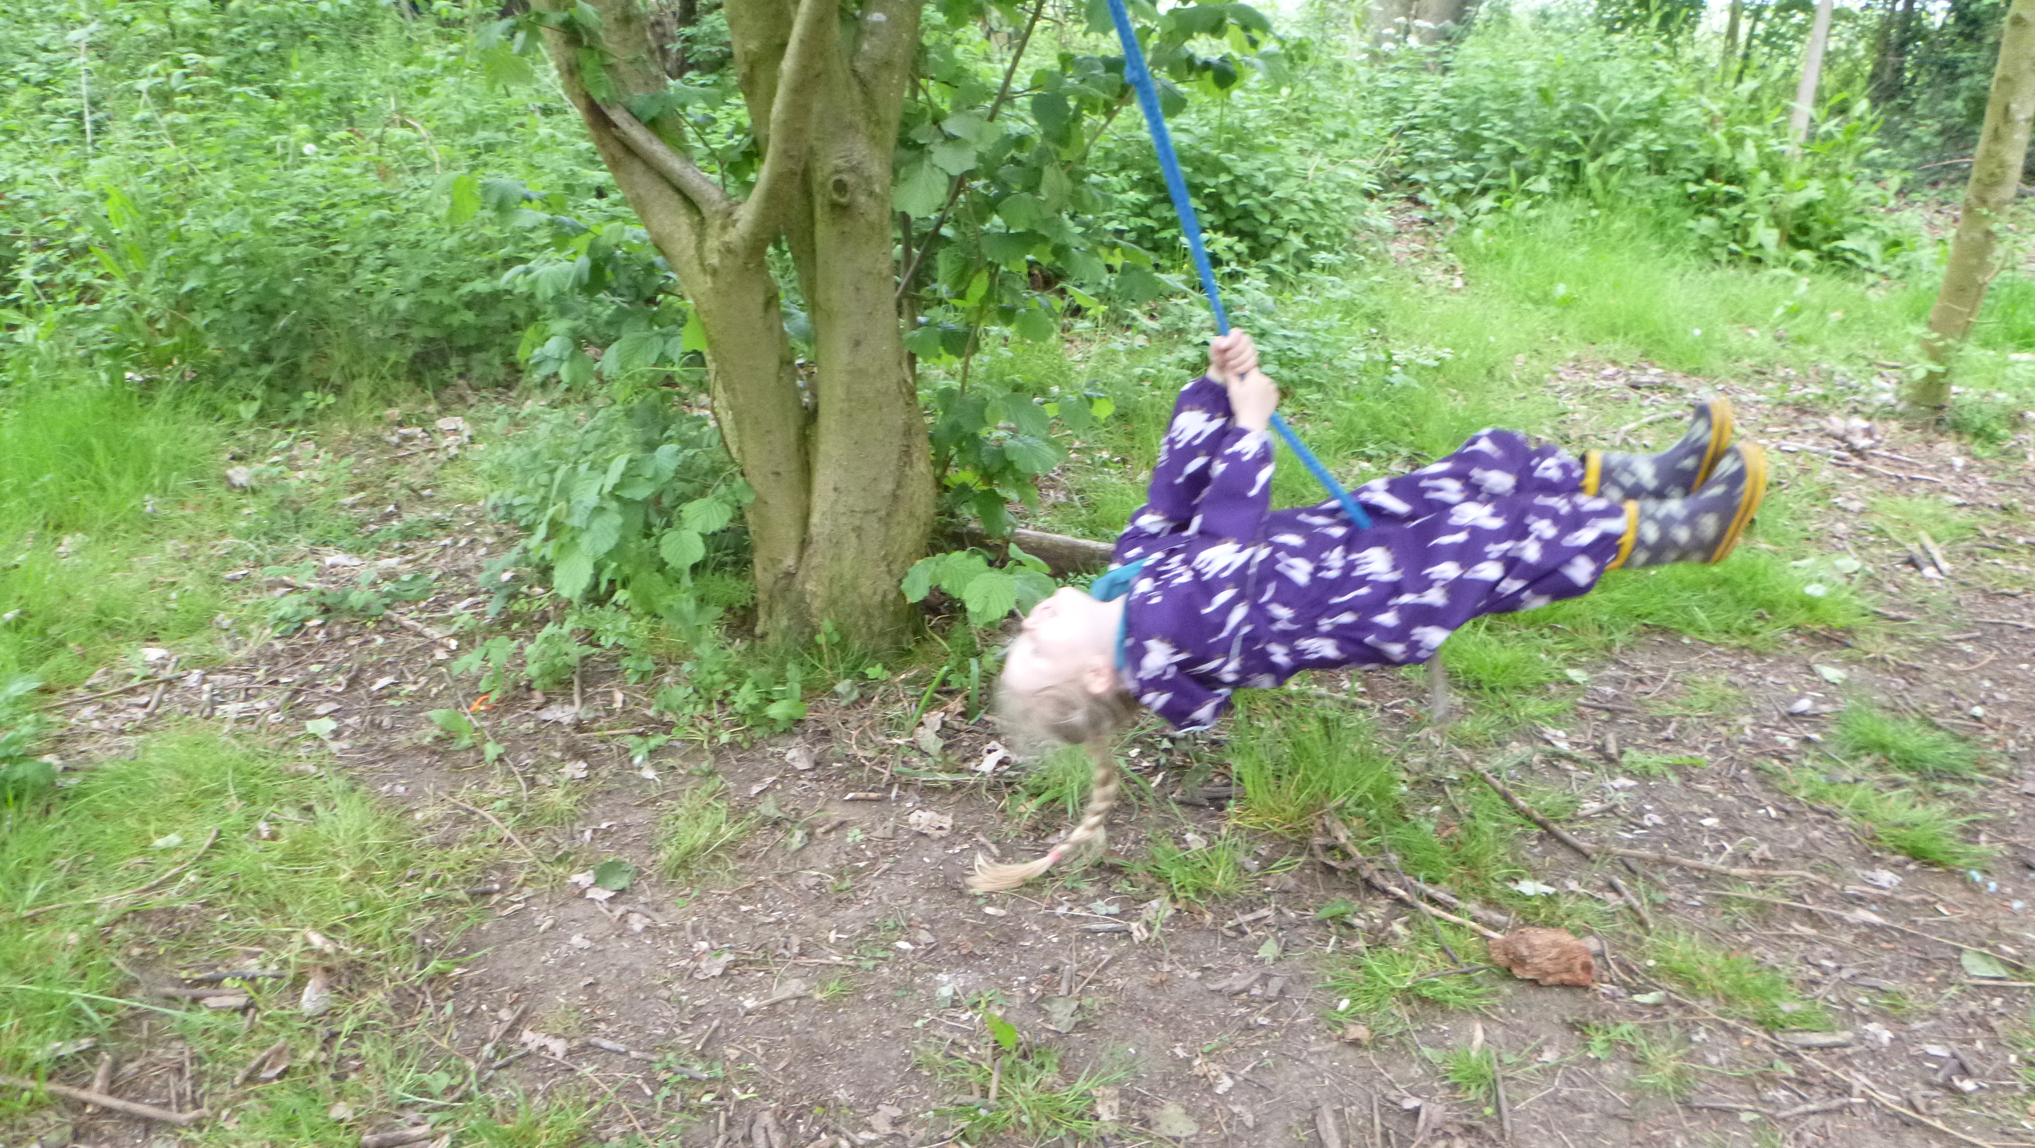
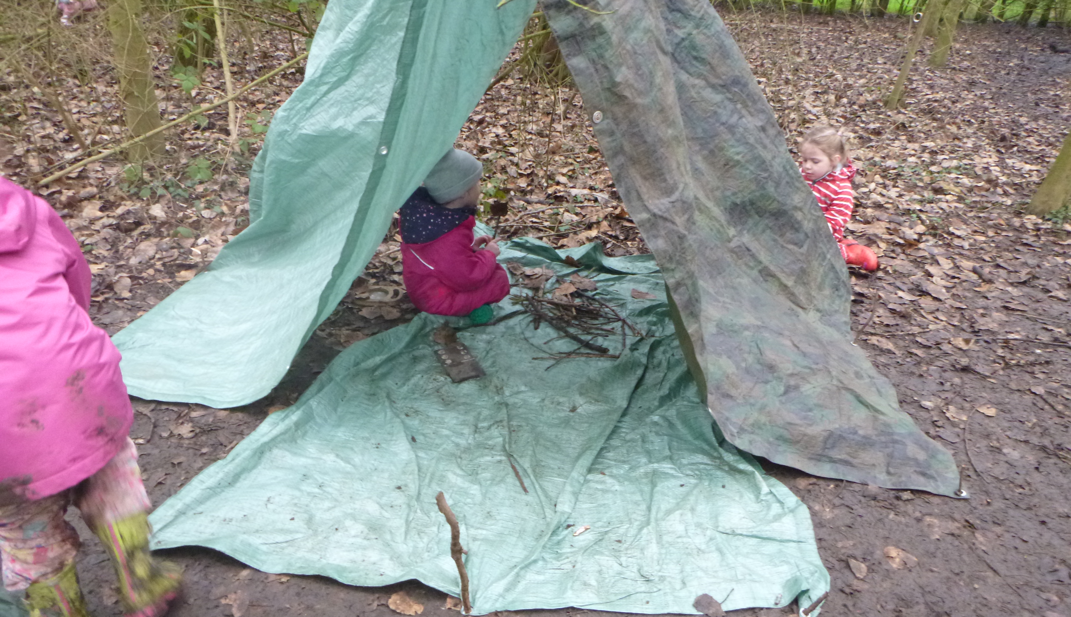
We go to our own Forest School every Friday.
Notes:
NOTE: To change images on this slide, select a picture and delete it. Then click the Insert Picture icon in the placeholder to insert your own image.

Slide 11
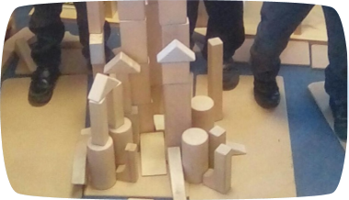
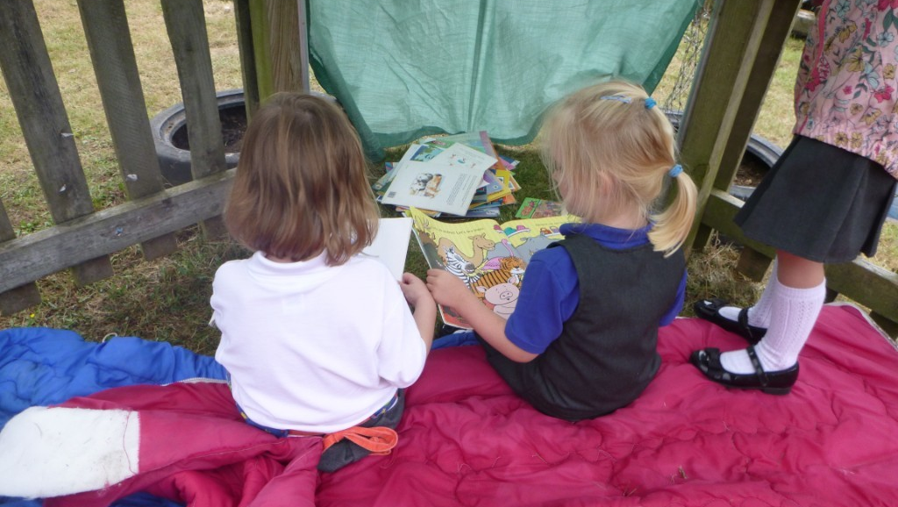
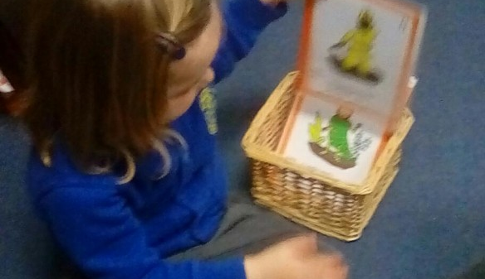
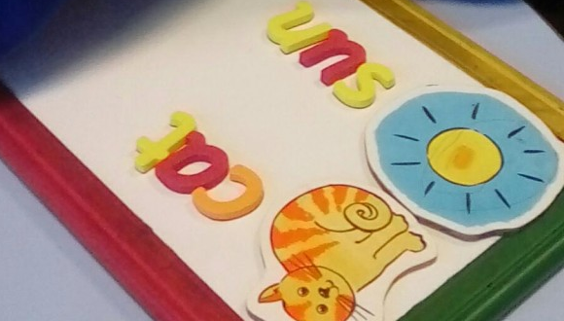
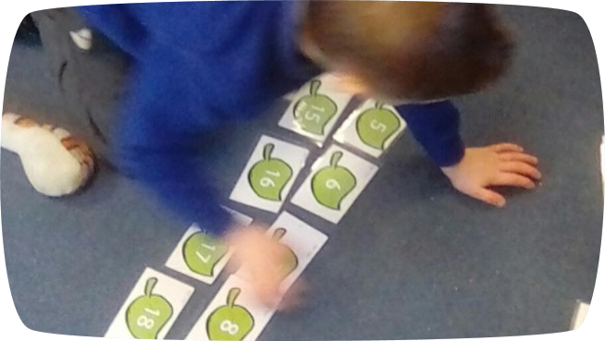
We love reading, writing and Maths in Kestrel class.
Notes:
NOTE: To change images on this slide, select a picture and delete it. Then click the Insert Picture icon in the placeholder to insert your own image.

Slide 12
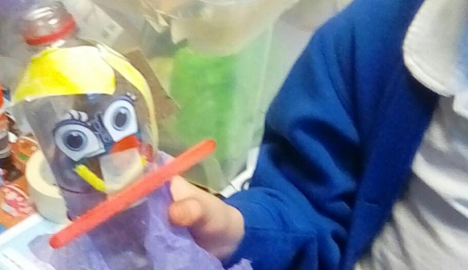
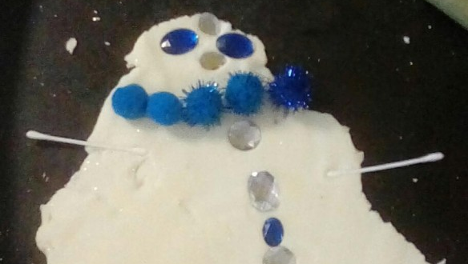
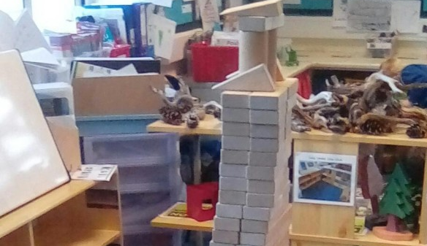
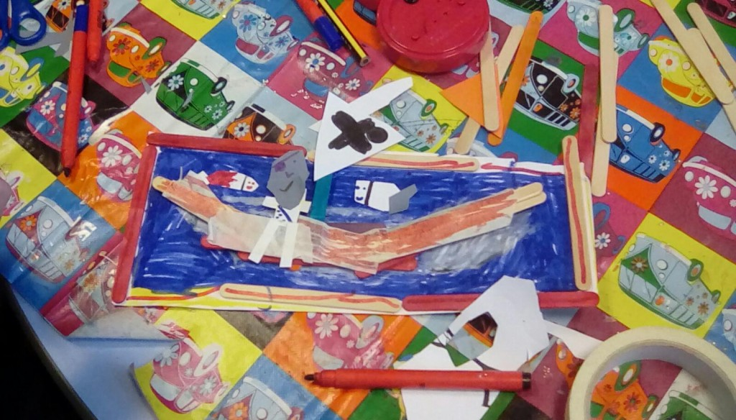
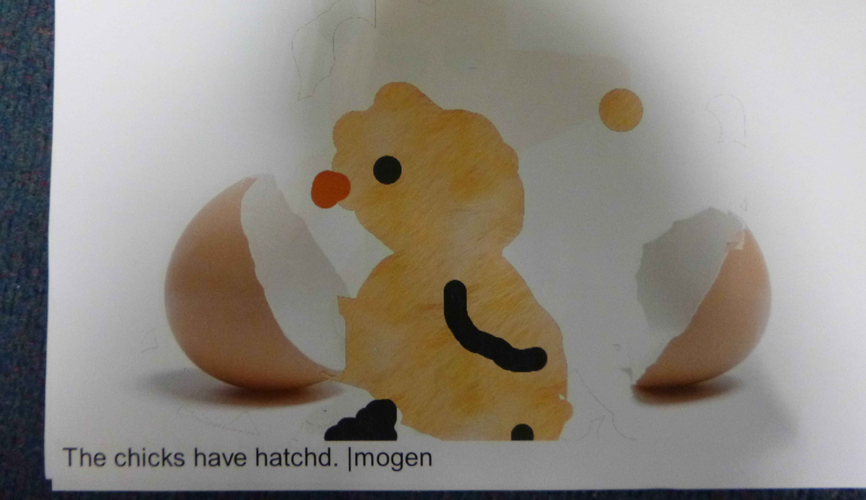
We love making things!
Notes:
NOTE: To change images on this slide, select a picture and delete it. Then click the Insert Picture icon in the placeholder to insert your own image.

Slide 13
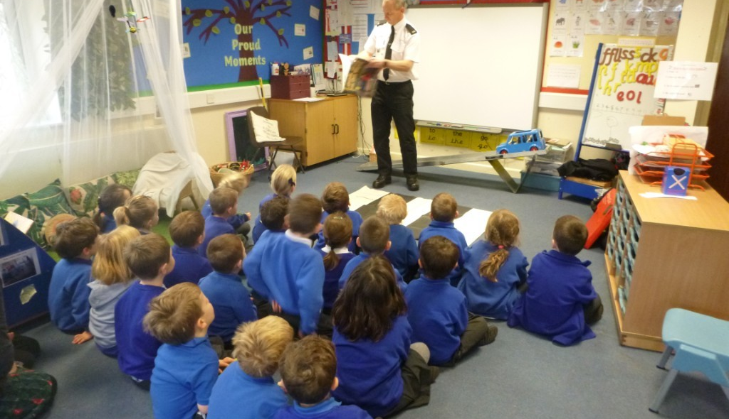
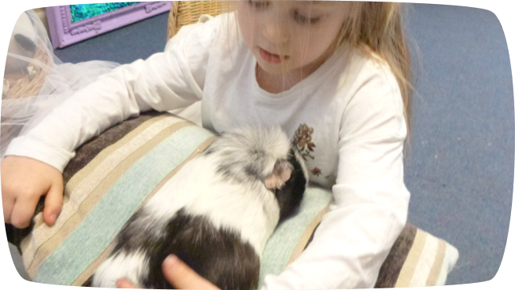
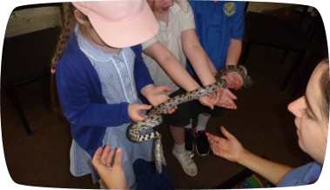
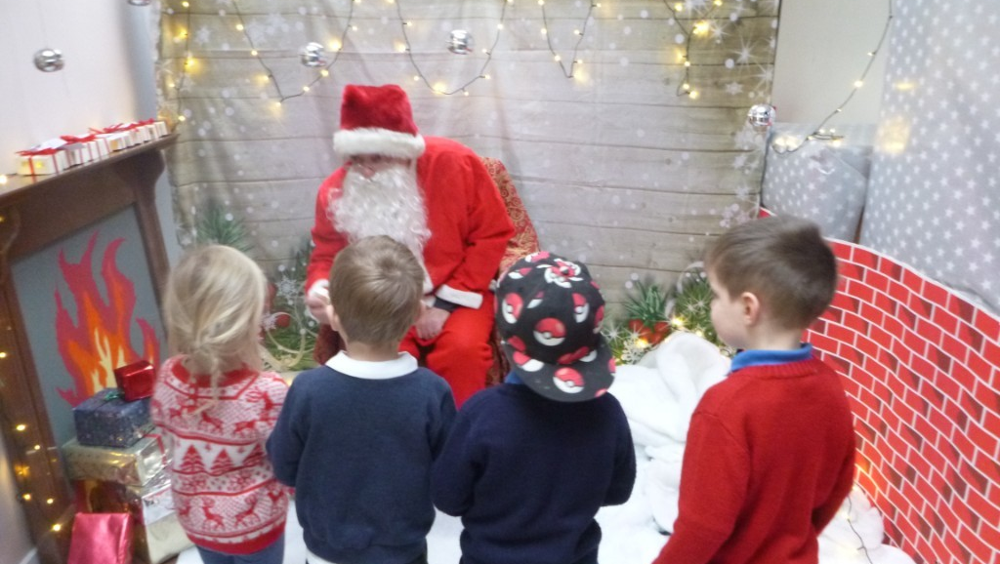
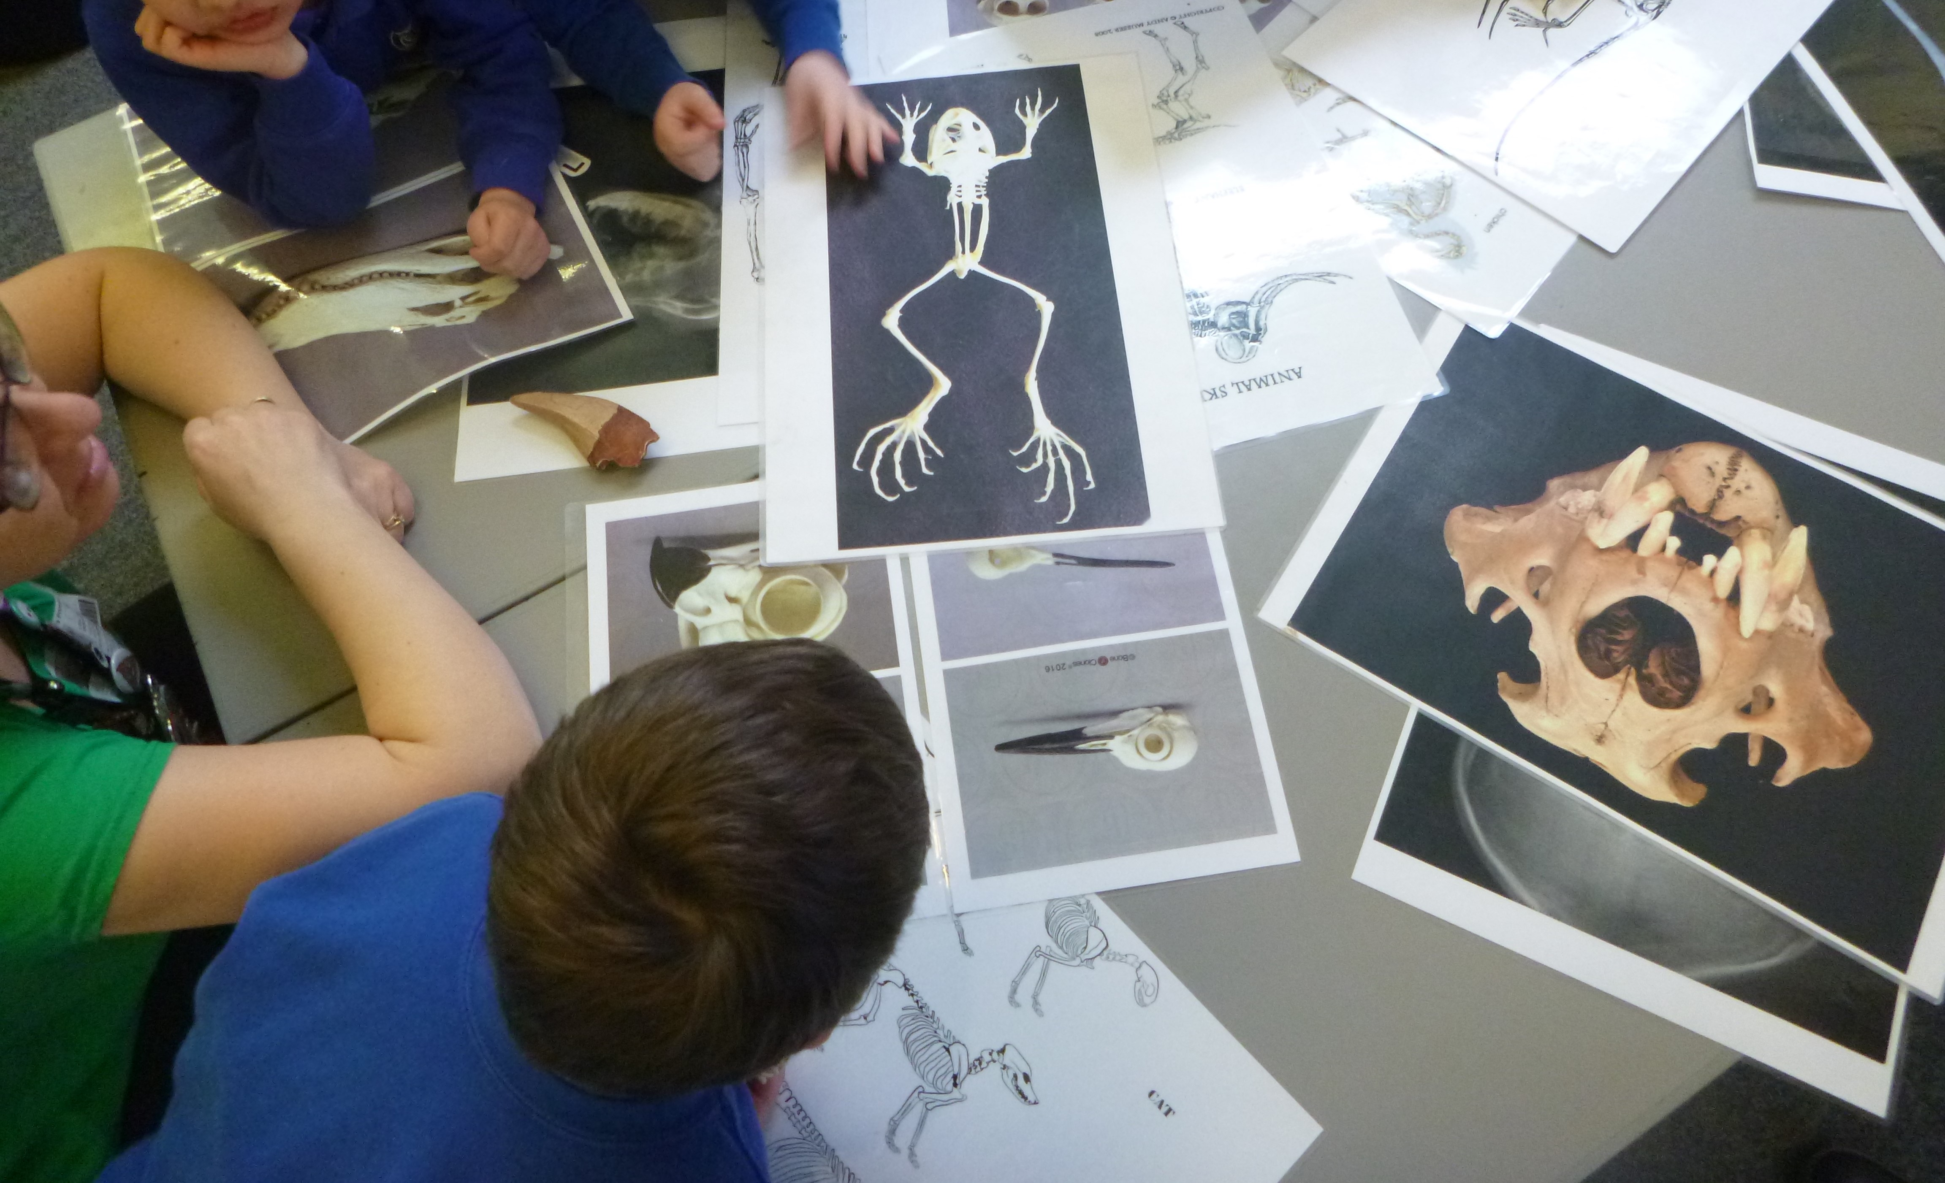
And we have lots of visitors come to see us too.
Notes:
NOTE: To change images on this slide, select a picture and delete it. Then click the Insert Picture icon in the placeholder to insert your own image.

Slide 14
We really can’t wait to meet you all in September.
I hope you have enjoyed looking through all of our photos and you now know a little more about us.
If you have any questions, then please let the school office know.
office@st-helens.cambs.sch.uk

