Slide 1
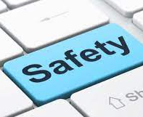
Internet Safety for Primary children

Slide 2



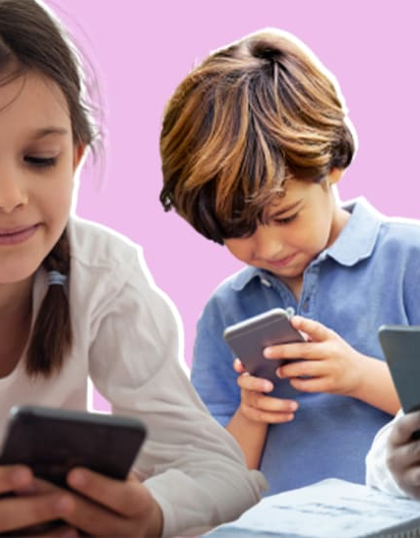
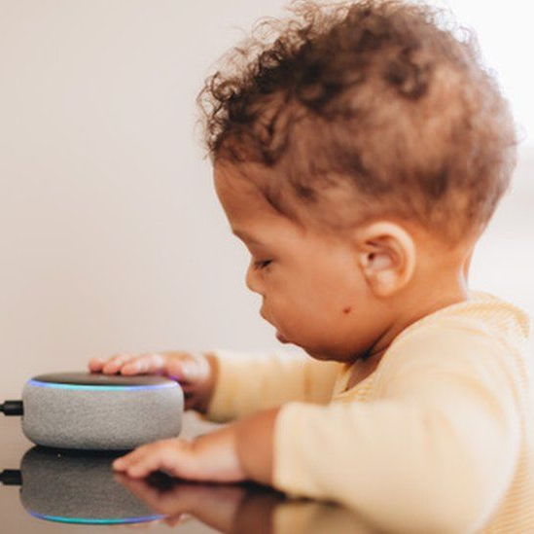
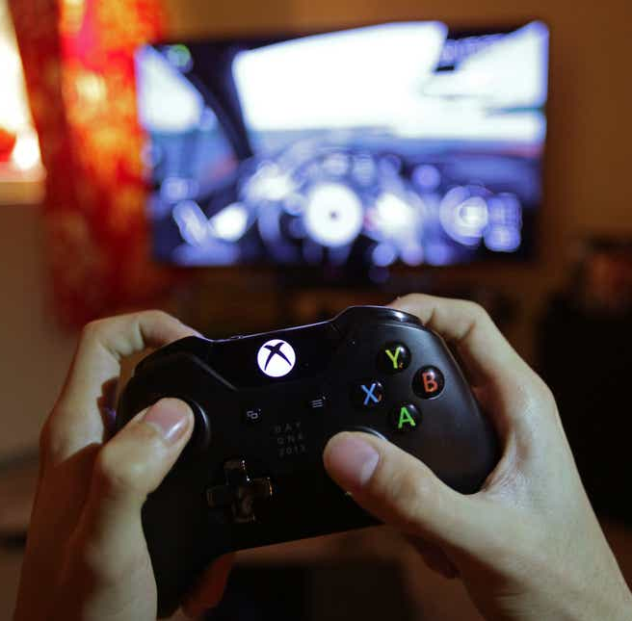
What internet connected technology can your child access?
Notes:
What does internet connected technology actually mean?
Technology is things that is made by people to help people.
Internet connected technology is technology that connects to the internet or uses the internet.
We all know the obvious ones: tablets, phones, laptops and computers.
Don’t forget about smart TVs, smart speakers (Alexa, Nest, etc) and games consoles.

Slide 3
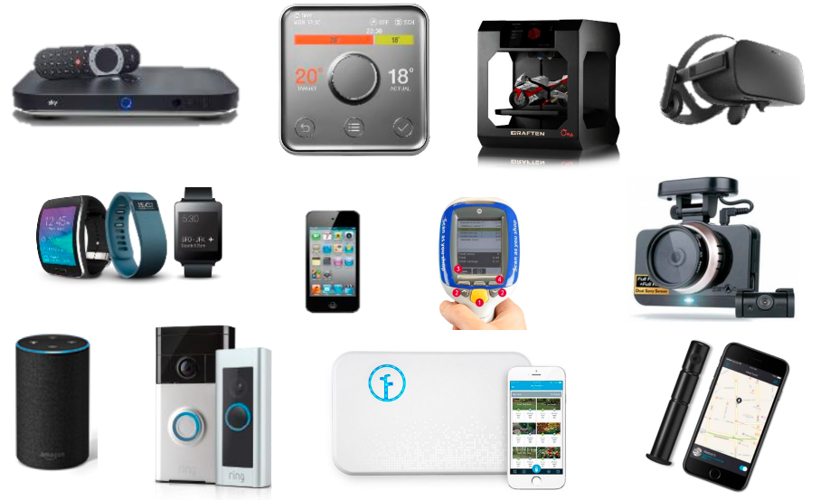
Notes:
Even cars and fridges are now becoming more accessible with built in internet access!
And if you’re thinking of technology that uses the internet (rather than you being able to access the internet through it), then you also have smart watches, doorbells, webcams, Tesco shop scanner, thermostat, washing machine…and the list goes on!

Slide 4
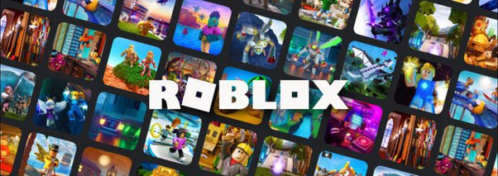
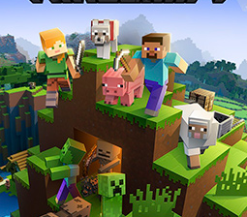
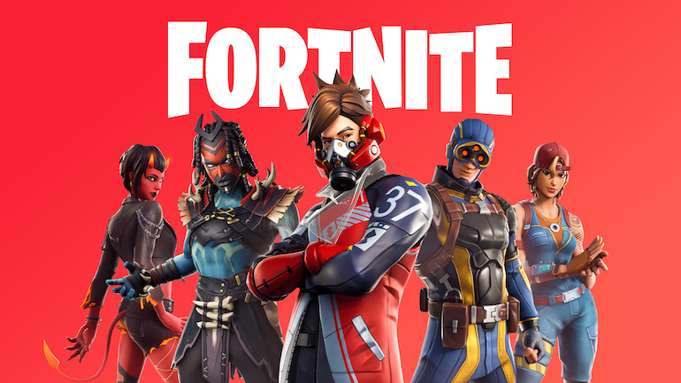
What does your child access?
Notes:
Youtube, TikTok, Snapchat Instagram, Facebook, Whatsapp, Signal, Telegram, Roblox, Fortnight, Minecraft, etc
Some of these may be fine if you and they know exactly who they are talking to but do we always know who they are talking to? Do we know what they’re talking about?
Is your child being the kind-hearted person that you’ve brought up? What are they listening to? What are others saying to them? It’s a lot to think about!
The 4 key potential risks of online gaming are being contacted by people that they do not know, encountering inappropriate adult content, bullying and overspending.

Slide 5
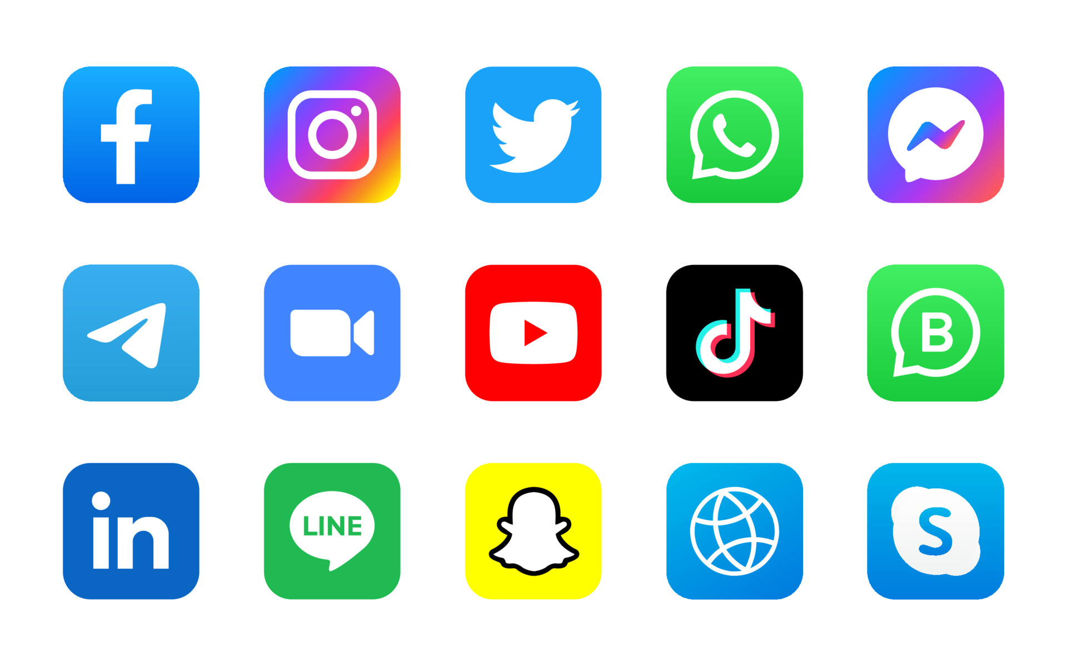
What does your child access?
Notes:
Again, we have the issues of do we always know who they are talking to? Do we know what they’re talking about? What images are they sending/seeing?
Most social media is aged at 13+. Whatsapp is 16+.There is a reason for these age limits.
So many of us have had emails, Facebook messages, etc from someone who we don’t know (for ‘help’ or ‘medical reasons’). If these are able to come through to us, what can come through on children’s accounts?
It’s also important at this point to remember that the internet uses algorithms to ‘help’ us find our next video, image, etc. It really doesn’t take many clicks to go from something as simple as Peppa Pig to something highly inappropriate.

Slide 6
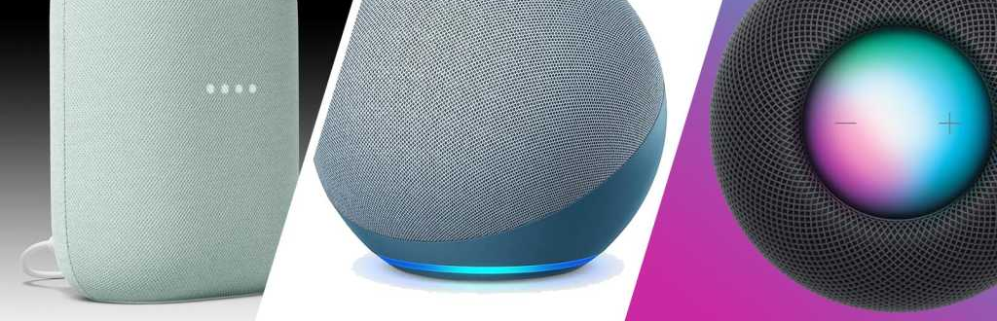
What does your child access?
Notes:
And then we have the Smart speakers that so many of us have (whether they be plugged in to the wall, built in to our TV remotes or on our phones).
What are they asking Alexa, Google or Siri?
What are the linked algorithms? Where will it go?

Slide 7

Positive effects of the Internet
Play, learning and having fun
Self expression and identity
Social interaction
Help and advice
Notes:
The positive effects
Play, learning and having fun
Through play, children and young people learn about themselves, their environment, people and the world around them. Playing games online can boost learning, health (if the games are interactive) and social skills. Those who play games have reported higher levels of emotional well-being than those who spend no time doing this at all.
Self-expression and identity
Self-expression is an important part of identity. Online, children and young people can try new things and experiment with different aspects of their identity and personality.
For younger children, creating profiles and avatars means they can try out different characters. This helps them to learn about themselves, what they like and don’t like, and how they interact with their friends. For young people, the internet can be an effective platform for positive self-expression. It lets young people put forward their ‘best self’ to express who they are and how they identify with the world around them.
Social relationships
Friendships are important when it comes to looking after mental well-being. People who feel more connected to others have lower levels of anxiety and depression.
Being online gives children and young people opportunities to develop and maintain positive relationships. They use technology to enhance their existing relationships and stay in touch with friends and family. In fact, research suggests that time spent online socialising with people they already know strengthens their relationships.
Technology also helps those who find face-to-face communication difficult. For example, children and young people who live in remote places can use the internet to stay connected with their friends when it’s harder to go out and play with them.
Help and advice
The internet can be a valuable source of information and support for children and young people. There are experts online who can help them when they are worried. Social media also gives children and young people an opportunity to read, listen to and understand the health experiences of others. These online interactions can help children and young people to overcome difficult health issues, particularly if they can’t access that support face-to-face.

Slide 8

Negative effects of the Internet
Physical health
Harmful content
Mental health
Notes:
The negative effects
Physical health
Keeping active, as well as eating and sleeping well, are important for physical health. Poor physical health can lead to an increased risk of developing mental health problems. Research has found that excessive screen time can have some negative impact on physical health. This includes physical problems such as strained eyes, back pain or hand aches from excessive use of devices. Research also suggests using screens can increase eating, as well as reducing the time spent on physical activity, which will have an impact on overall health and well-being. Sleep disruption is identified as an impact of using screens at night, because the bright screen light from devices can cause increased alertness and activities can be stimulating and make children less ready to sleep.
Harmful content
When children and young people look for help online, they won’t always find websites or people that are trustworthy.
Accessing unwanted or unsuitable content can be upsetting and negatively impact mental health. This is especially true for younger children who have not developed the emotional skills to cope with difficult or stressful situations. Some websites might also imply that unhealthy behaviours, such as eating disorders or self-harm, can be normal lifestyle choices.
Children being targeted for sexualisation, grooming, terrorism and county lines.
Mental Health (coming up next)

Slide 9
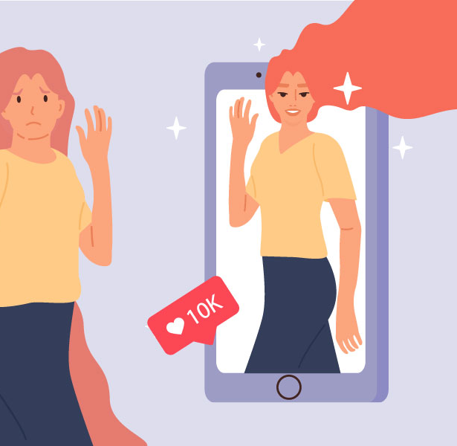
The Internet and Mental Health
Notes:
Self image
Our children are bombarded with ‘perfect’ images. They are being brought up in a world where filters are automatically used in a photo. What message does this give to them?
If children are surrounded with other people having a ‘perfect’ life, and they realise that their life is imperfect (otherwise known as normal) then that is where our troubles start. Children are already conscious of what they wear and how they look however we can ease this by limiting what they see, talking about things and leading by example.
Ask yourself: What are you sharing? Why are you sharing it? What message are we giving to our children by doing this?
Remember, once something is online, it’s there forever!
Remind children of this too. Lead by example.
Online bullying
As discussed earlier, what is your child discussing online? Are they applying the rules of to ‘treat others how you want to be treated’ online too? What are people saying to them? What may start as banter, could progress. Do they know what is acceptable and what is not? Do they know how to report something? Do you know how to report something/someone?
Anxiety, depression, stress
If someone thinks they are unworthy of playing the game the right way, or of looking a certain way…this is of course going to affect their mental health. There could be multiple signs for this but at the end of the day, they feel inadequate. Their confidence will be knocked, they will have low self esteem.
There are too many sad stories of children and young adults who have self harmed or worse due to issues that have arose through the internet.

Slide 10

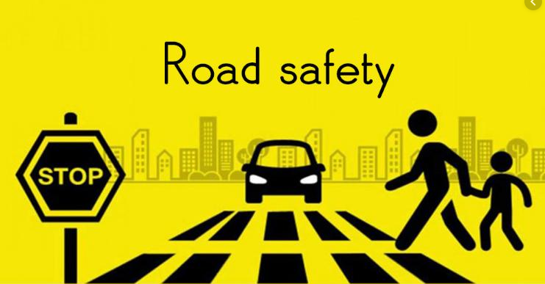
At what age should I discuss internet safety with my child?
ANY AGE!
Notes:
From young!
We teach our children about stranger danger and road safety. We talk about it from such a young age. We teach them about the dangers in real life. Virtual life is now part of real life!
Talk to them about their internet use. Model how to use it responsibly. Keep talking about it!
How and what to discuss with your child:
https://saferinternet.org.uk/guide-and-resource/parents-and-carers

Slide 11

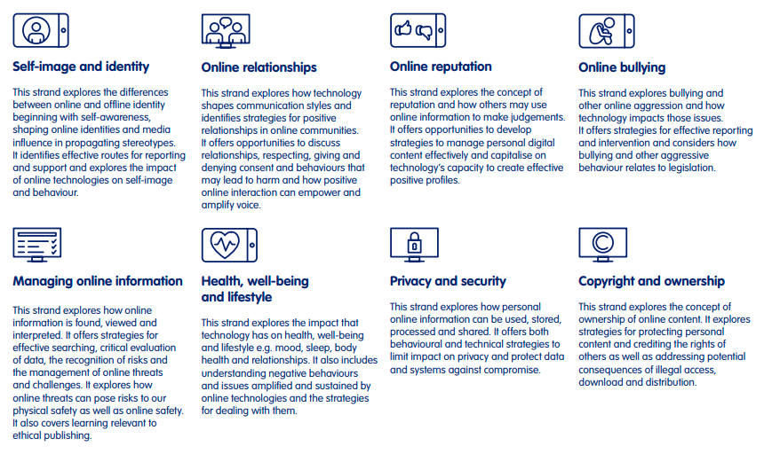
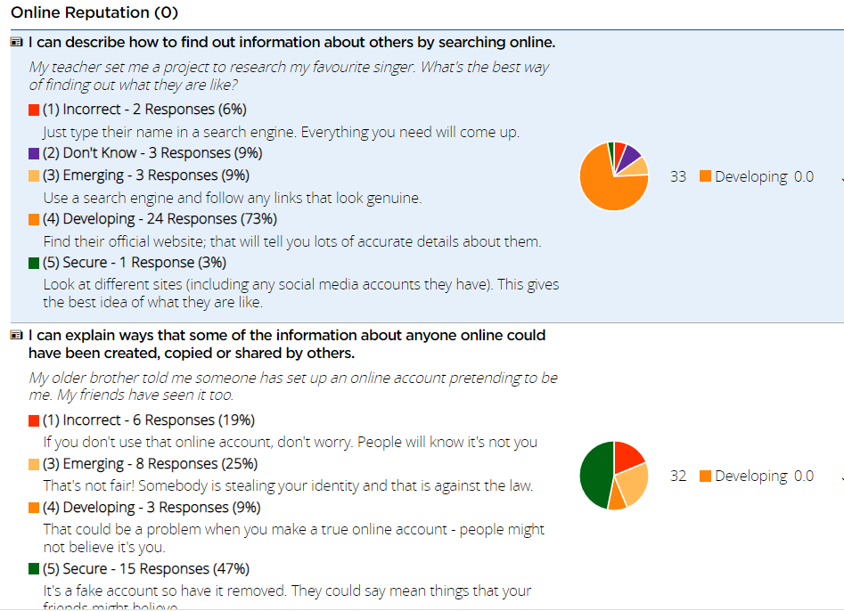
What are we doing at school?
Notes:
We are here tonight.
We have completed some extra work during internet safety week.
We model good use of the internet in class.
We talk about how to stay safe.
The DfE produced a document called Education for a Connected World. This says what the children should know through the different age groups.
We use a programme called Project Evolve which follows this. It enables us to chose a unit and year group to create a quiz, which we complete with the children. After completion, we can see what the children are/are not so confident with and then we have suggested activities linked to the specific unit and year group.

Slide 12



So what can you do to keep your child safe?
Check the parental controls
Talk to your child
Ask them questions
Don’t leave them unaided
Lead by example
How to manage settings
Guide to technology
Internet connected devices
Notes:
Talk to them, ask questions. What do they like to use the internet for? How do they search for something? What do they like to watch? What websites do they like to use?
Get them to teach you so you can see what and how they do it.
Parental controls (see SWGfL link).
Don’t allow them to be unaided.
Lead by example
Links
https://swgfl.org.uk/resources/checklists/
https://saferinternet.org.uk/guide-and-resource/parents-and-carers
https://www.nspcc.org.uk/keeping-children-safe/online-safety/internet-connected-devices/

